Slide 1

Jiarui Guo
Clarissa Song
Novin Changizi
Melissa Khuat
usability testing, paper prototyping
paper prototyping, writing
writing, usability testing
digital mockup, project manager
Notes:
Novin Changizi: writing, usability testing
Melissa Khuat: digital mockup, project manager
Clarissa Song: paper prototyping, writing
Jiarui Guo: usability testing, paper prototyping

Slide 2
Problem
Distracting behaviors while driving:
Texting,
Calling,
Scenery,
Makeup,
Drinking,
Exhaustion...
Notes:
So the problem is obvious right? People need to learn the consequences of distracted driving.

Slide 3
How bad can it be?
Each day in the United States, over 1,161 people are injured and over 8 people are killed in crashes that are reported to involve a distracted driver.
Notes:
And, that over 8 people are killed because distracted drivers

Slide 4
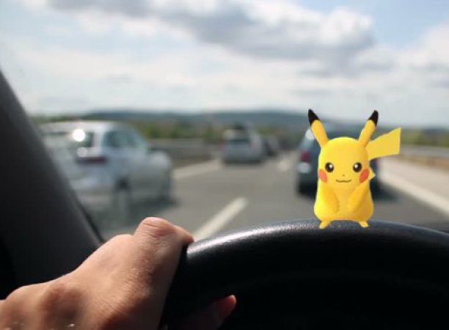
How many of you still engaged in distracting behaviors while driving after the previous presentation?

Slide 5
How can we encourage and reinforce safer driving habits?

Slide 6
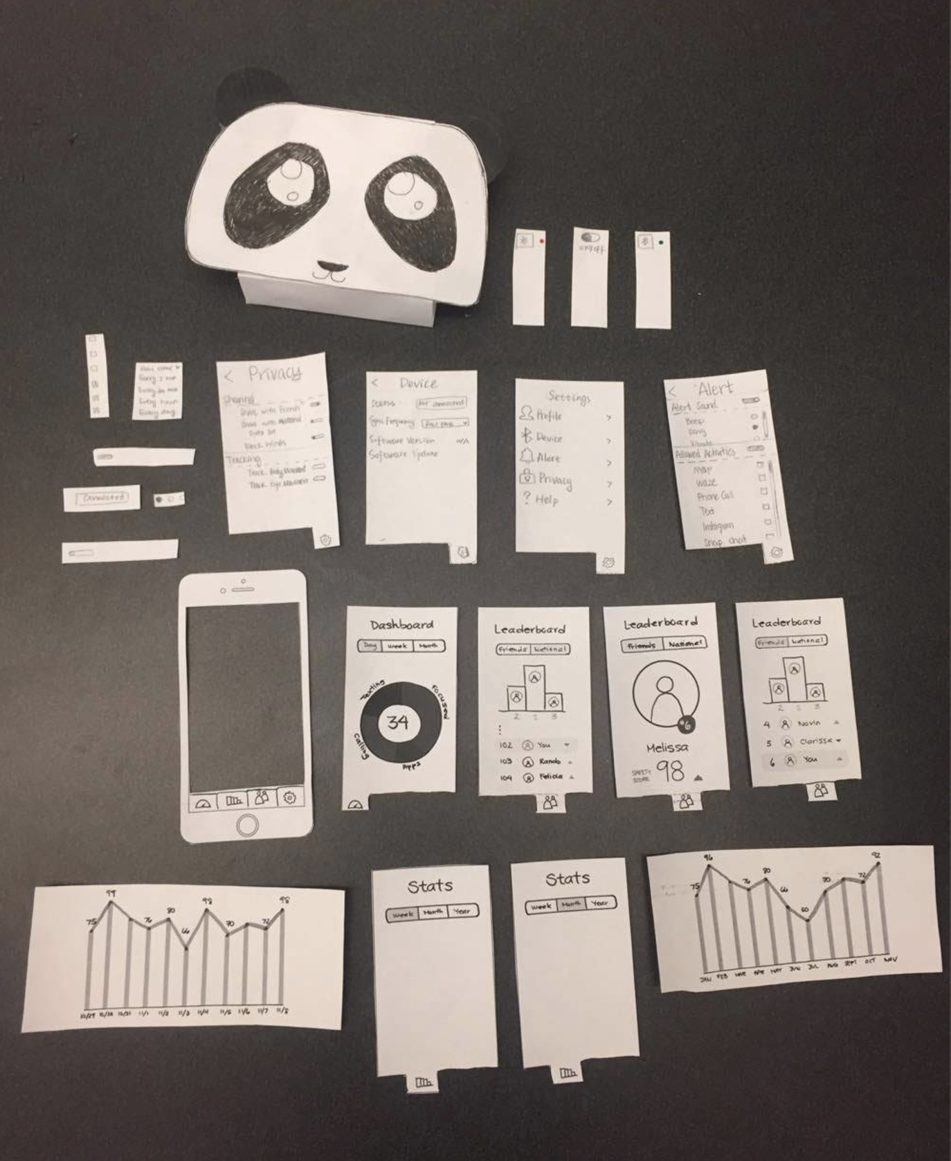
Initial Paper Prototype | OVERVIEW

Slide 7
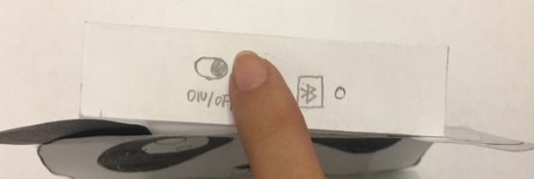
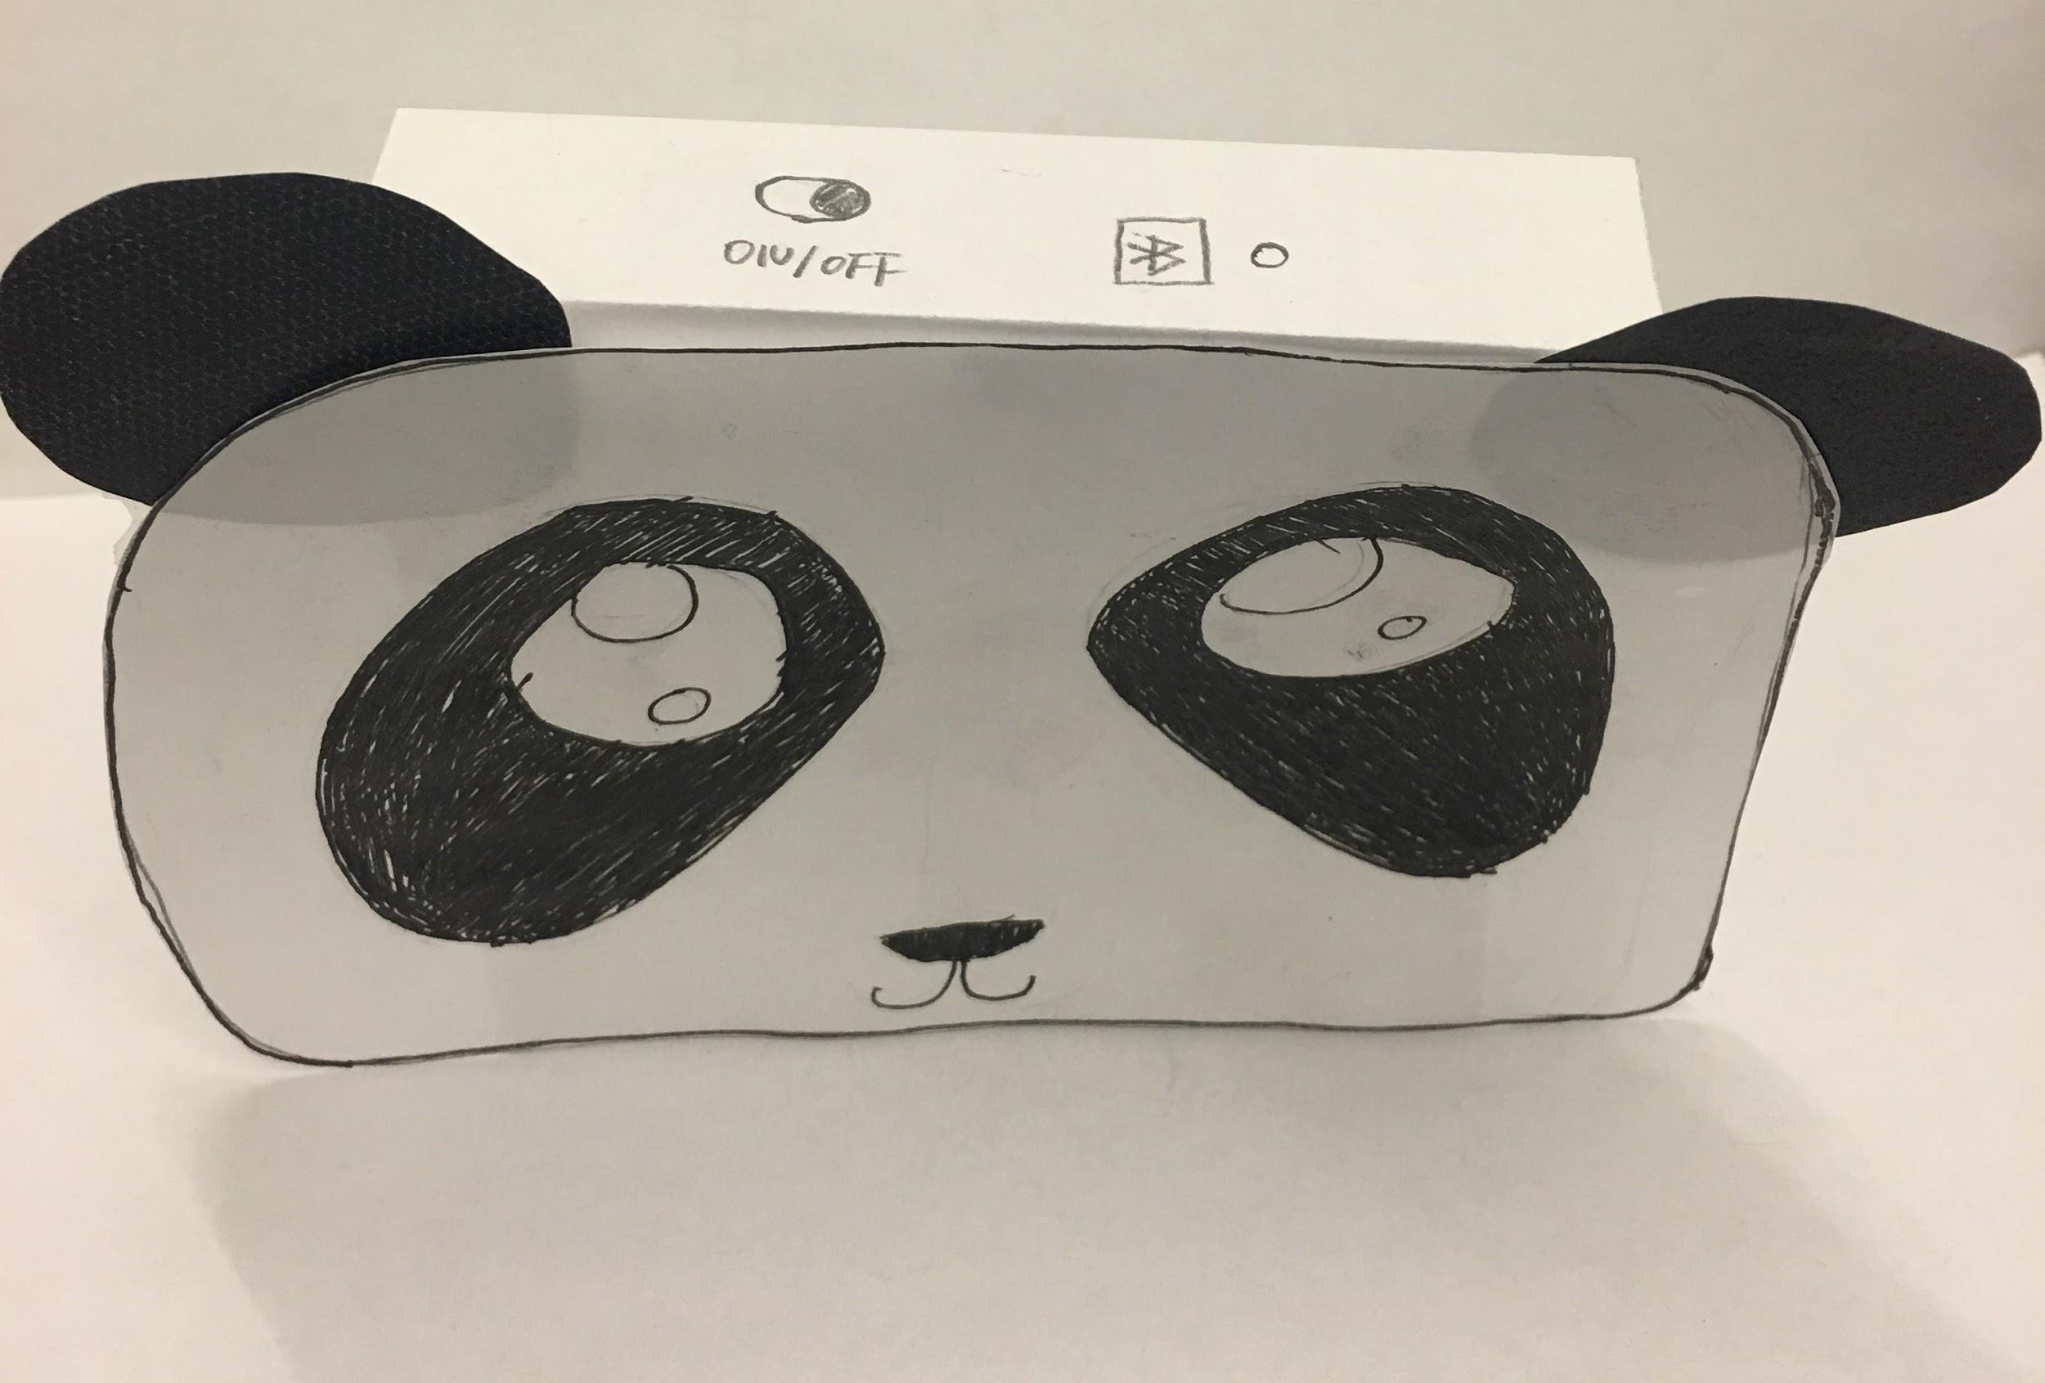
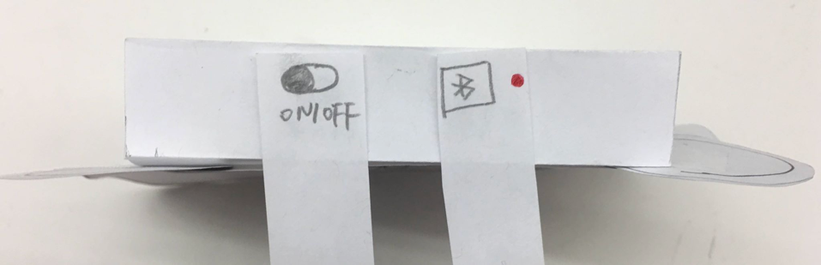
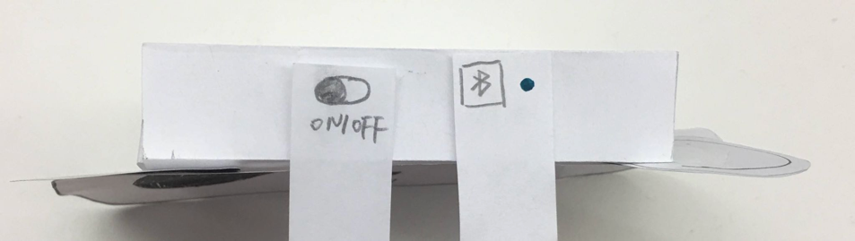
Initial Paper Prototype
TASK 1: PROCESSING & VISUALIZING DATA
Turn on and connect device

Slide 8
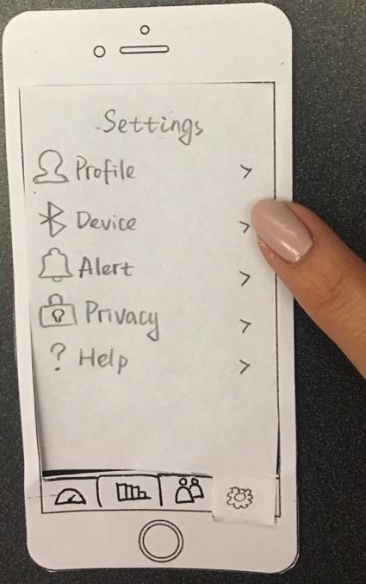
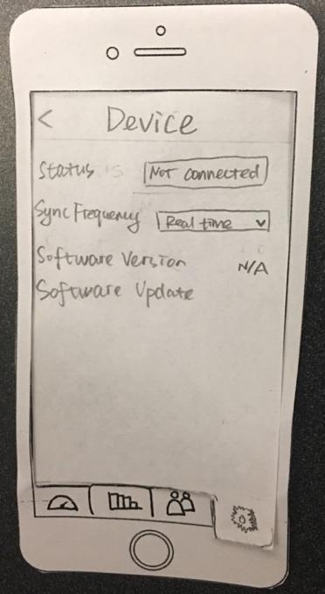
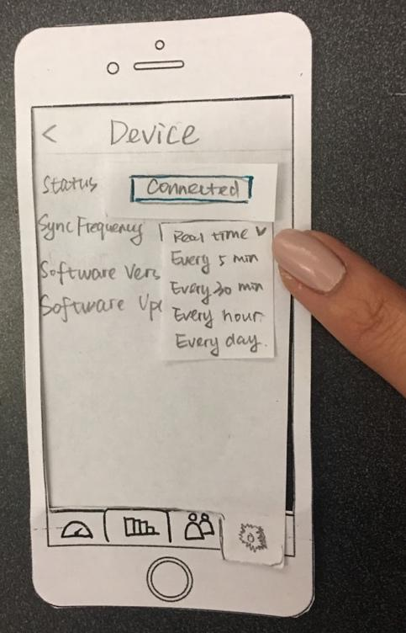
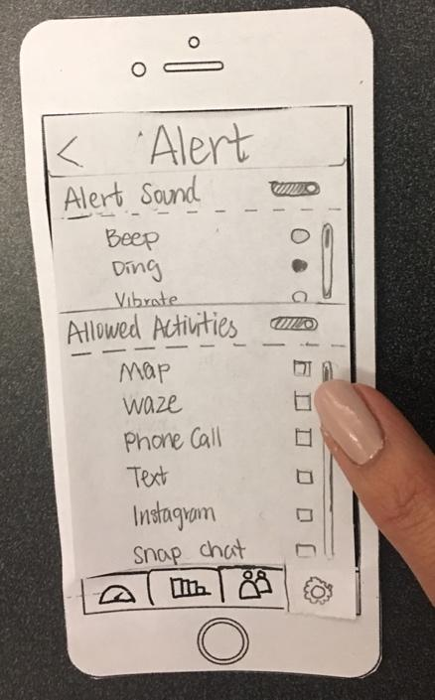
Initial Paper Prototype
TASK 1: PROCESSING & VISUALIZING DATA
Settings
Device Settings
Alert Settings

Slide 9
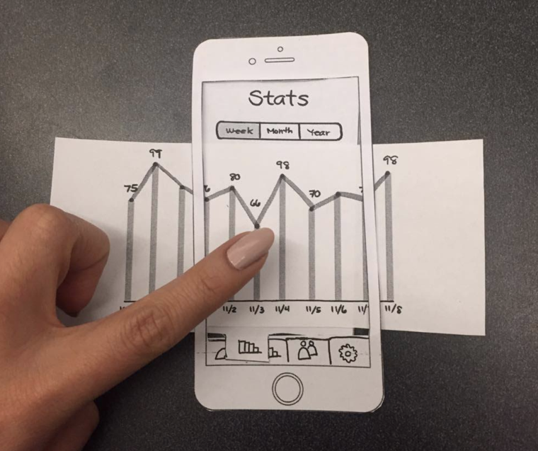
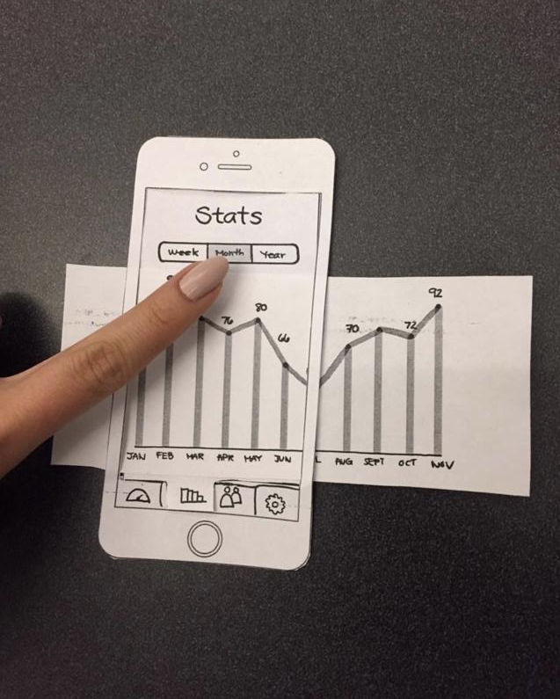
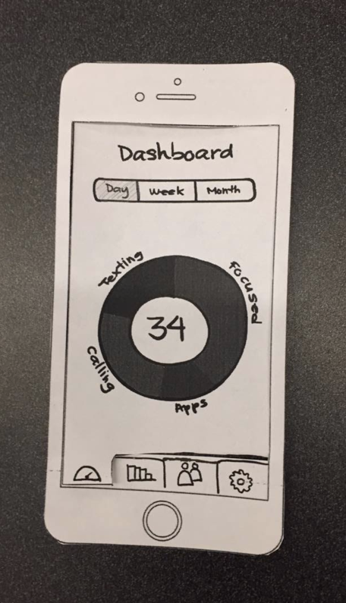
Initial Paper Prototype
TASK 1: PROCESSING & VISUALIZING DATA
Dashboard Summary
Stats view → Scrolling for more → Switch to month view

Slide 10
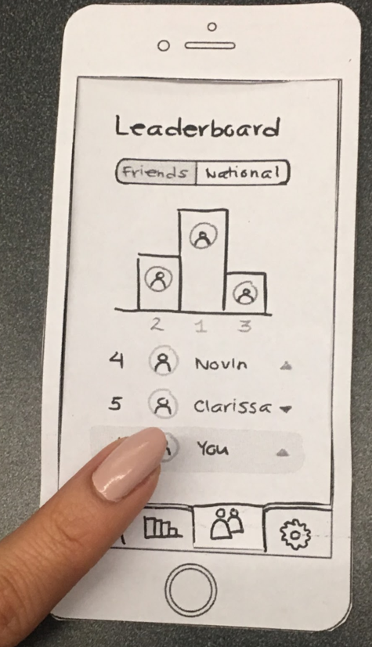
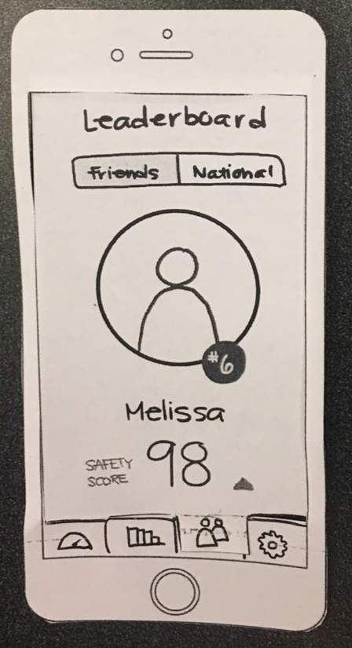
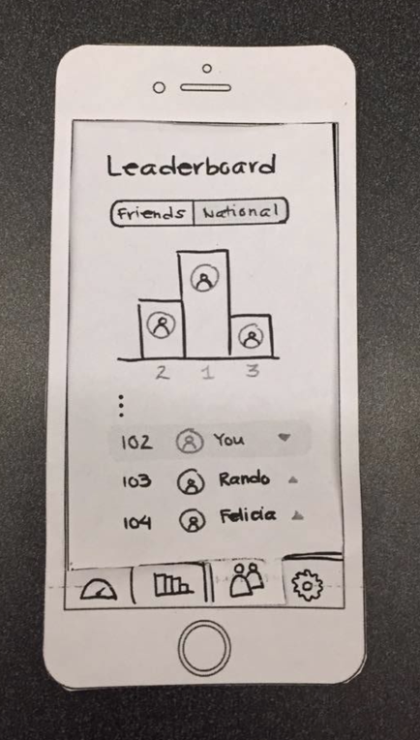
Initial Paper Prototype
TASK 2: Sharing & Comparing Driving Habits
Friend View of Leaderboard
Individual Profile
National View of Leaderboard

Slide 11
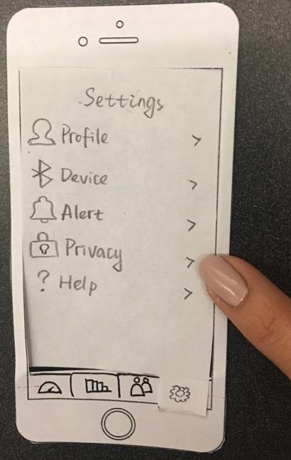
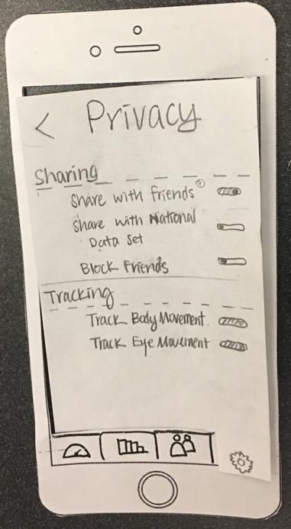
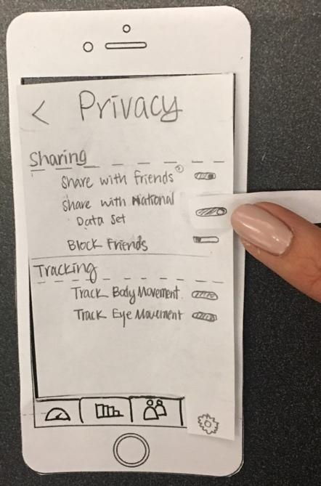
Initial Paper Prototype
TASK 2: Sharing & Comparing Driving Habits
Privacy Settings

Slide 12
Testing Process & Results
PARTICIPANTS & METHODS
Three participants
Male and female
First two males were inexperienced drivers
Last was semi-experienced female driver (~5 years)
Two parts to the test:
How user would use it for the first time: installation, pairing
How user would use it after a while: stats, leaderboard

Slide 13
Testing Process & Results
CRITICAL INCIDENTS
Issues addressed:
No affordance for clipping panda
Inconvenient button placement on panda
No details on how to connect panda
“Allowed activities” settings encouraged illegal activities
No detail view for data on stats or dashboard
Stats graphs did not afford clicking or scrolling
No capability to add/remove friends

Slide 14
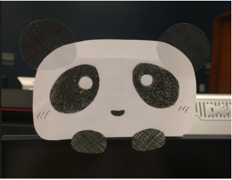
No Affordance for Clipping Panda
So we added clips to the bottom

Slide 15
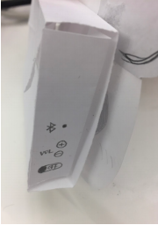
Inconvenient button placement on the panda
So we put the buttons on the left side

Slide 16
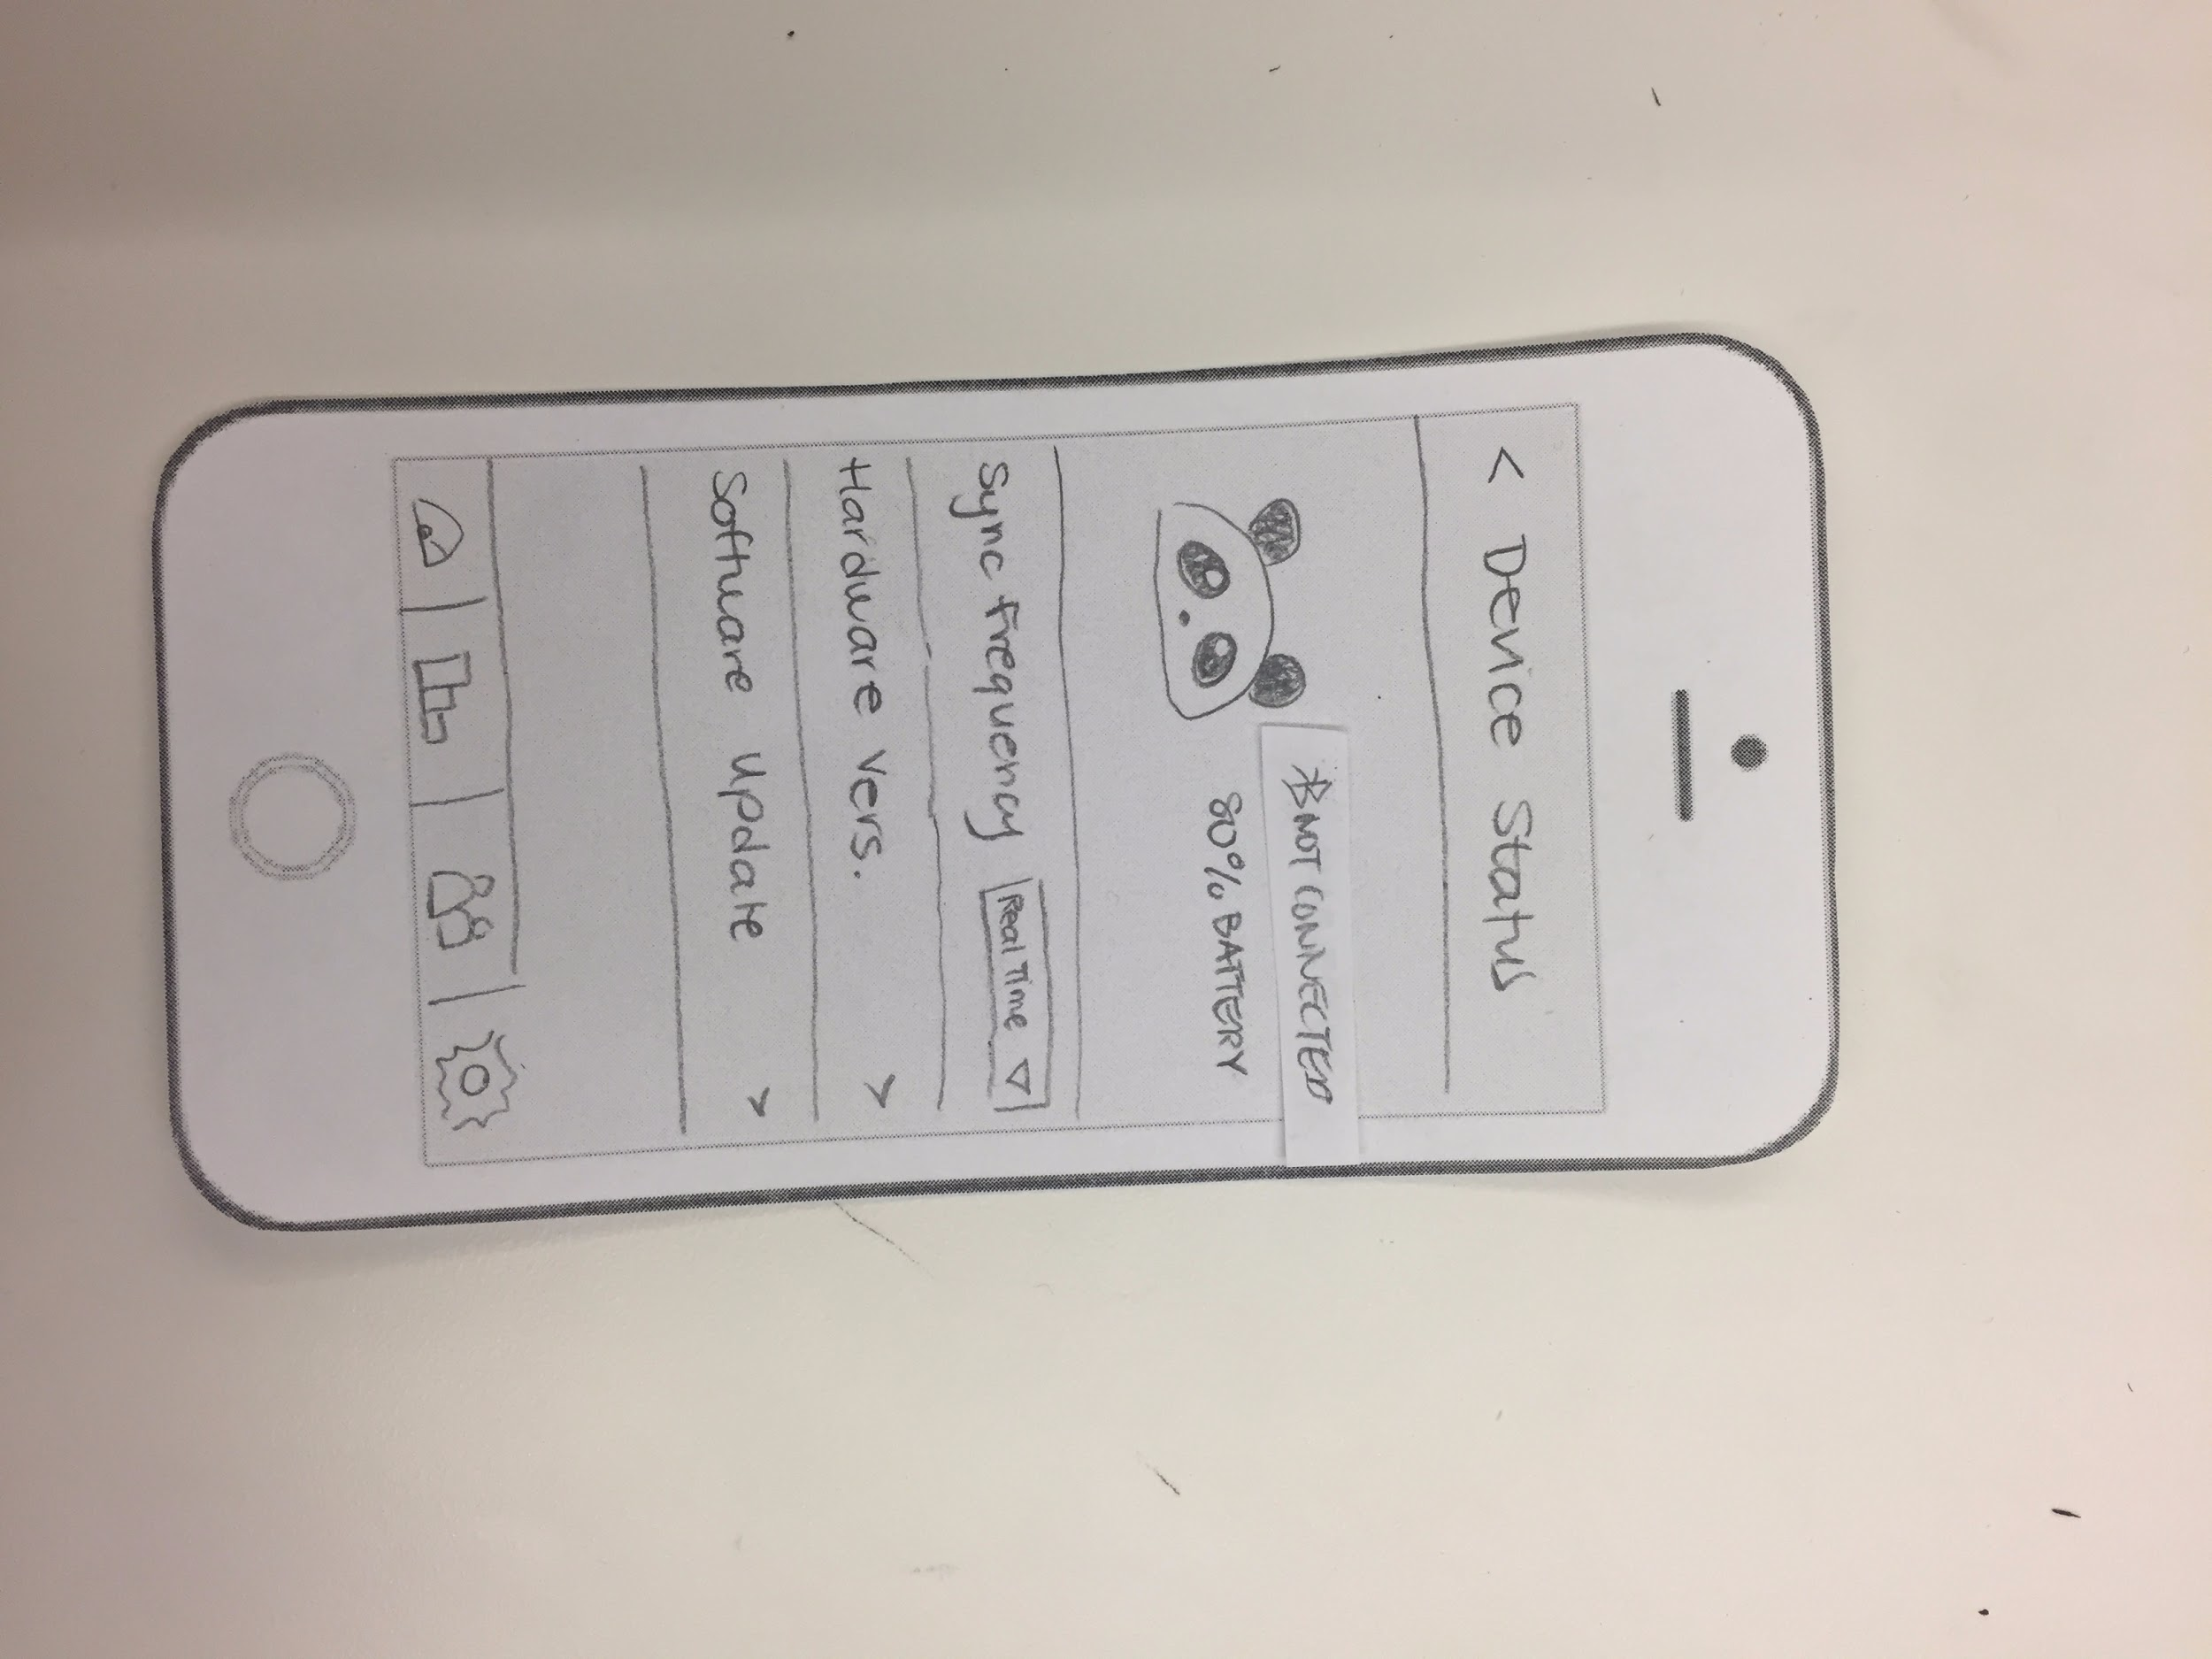
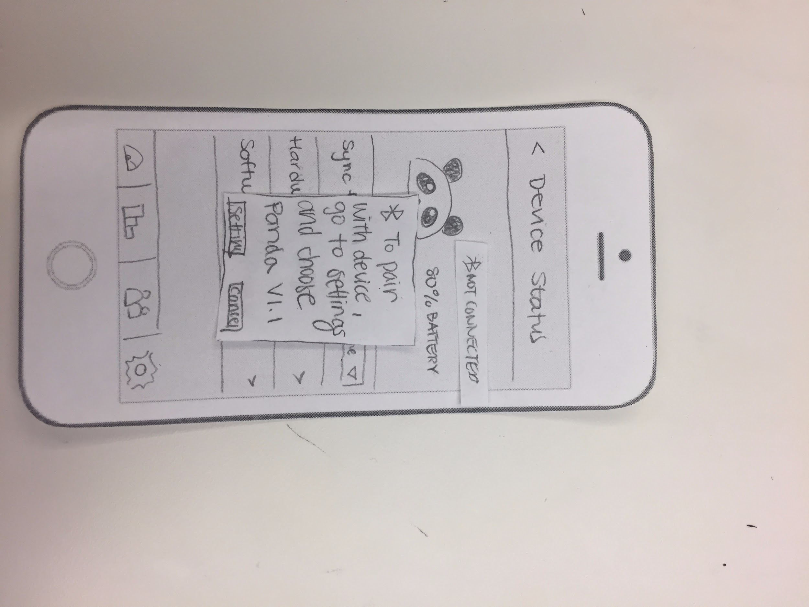
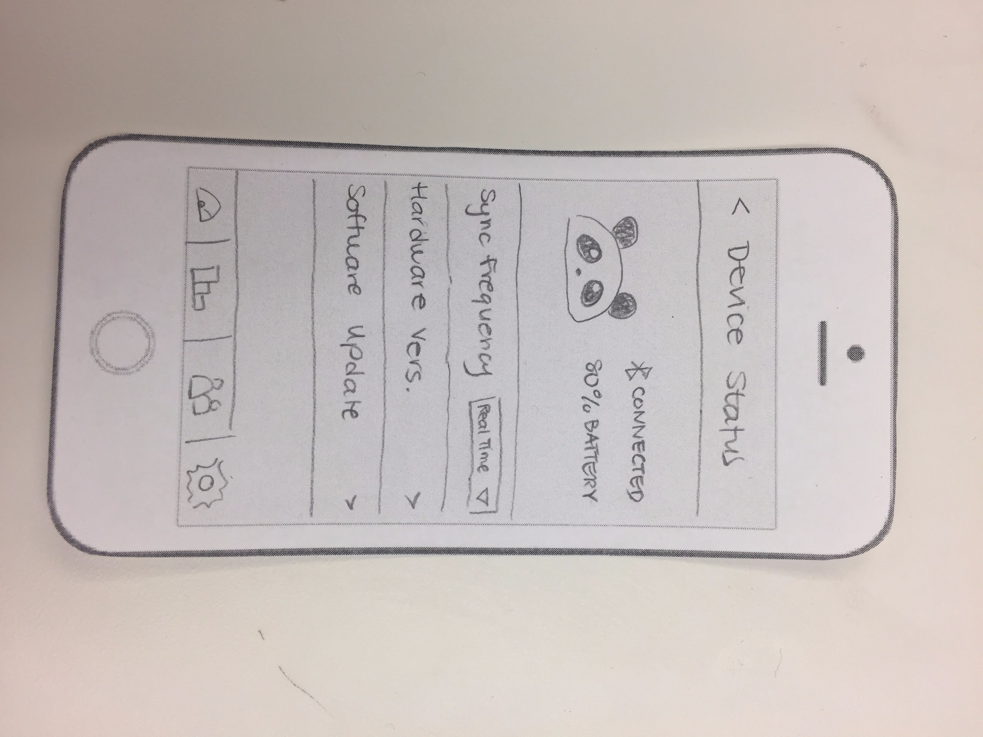
No details on how to connect panda
Se we added it to the settings

Slide 17
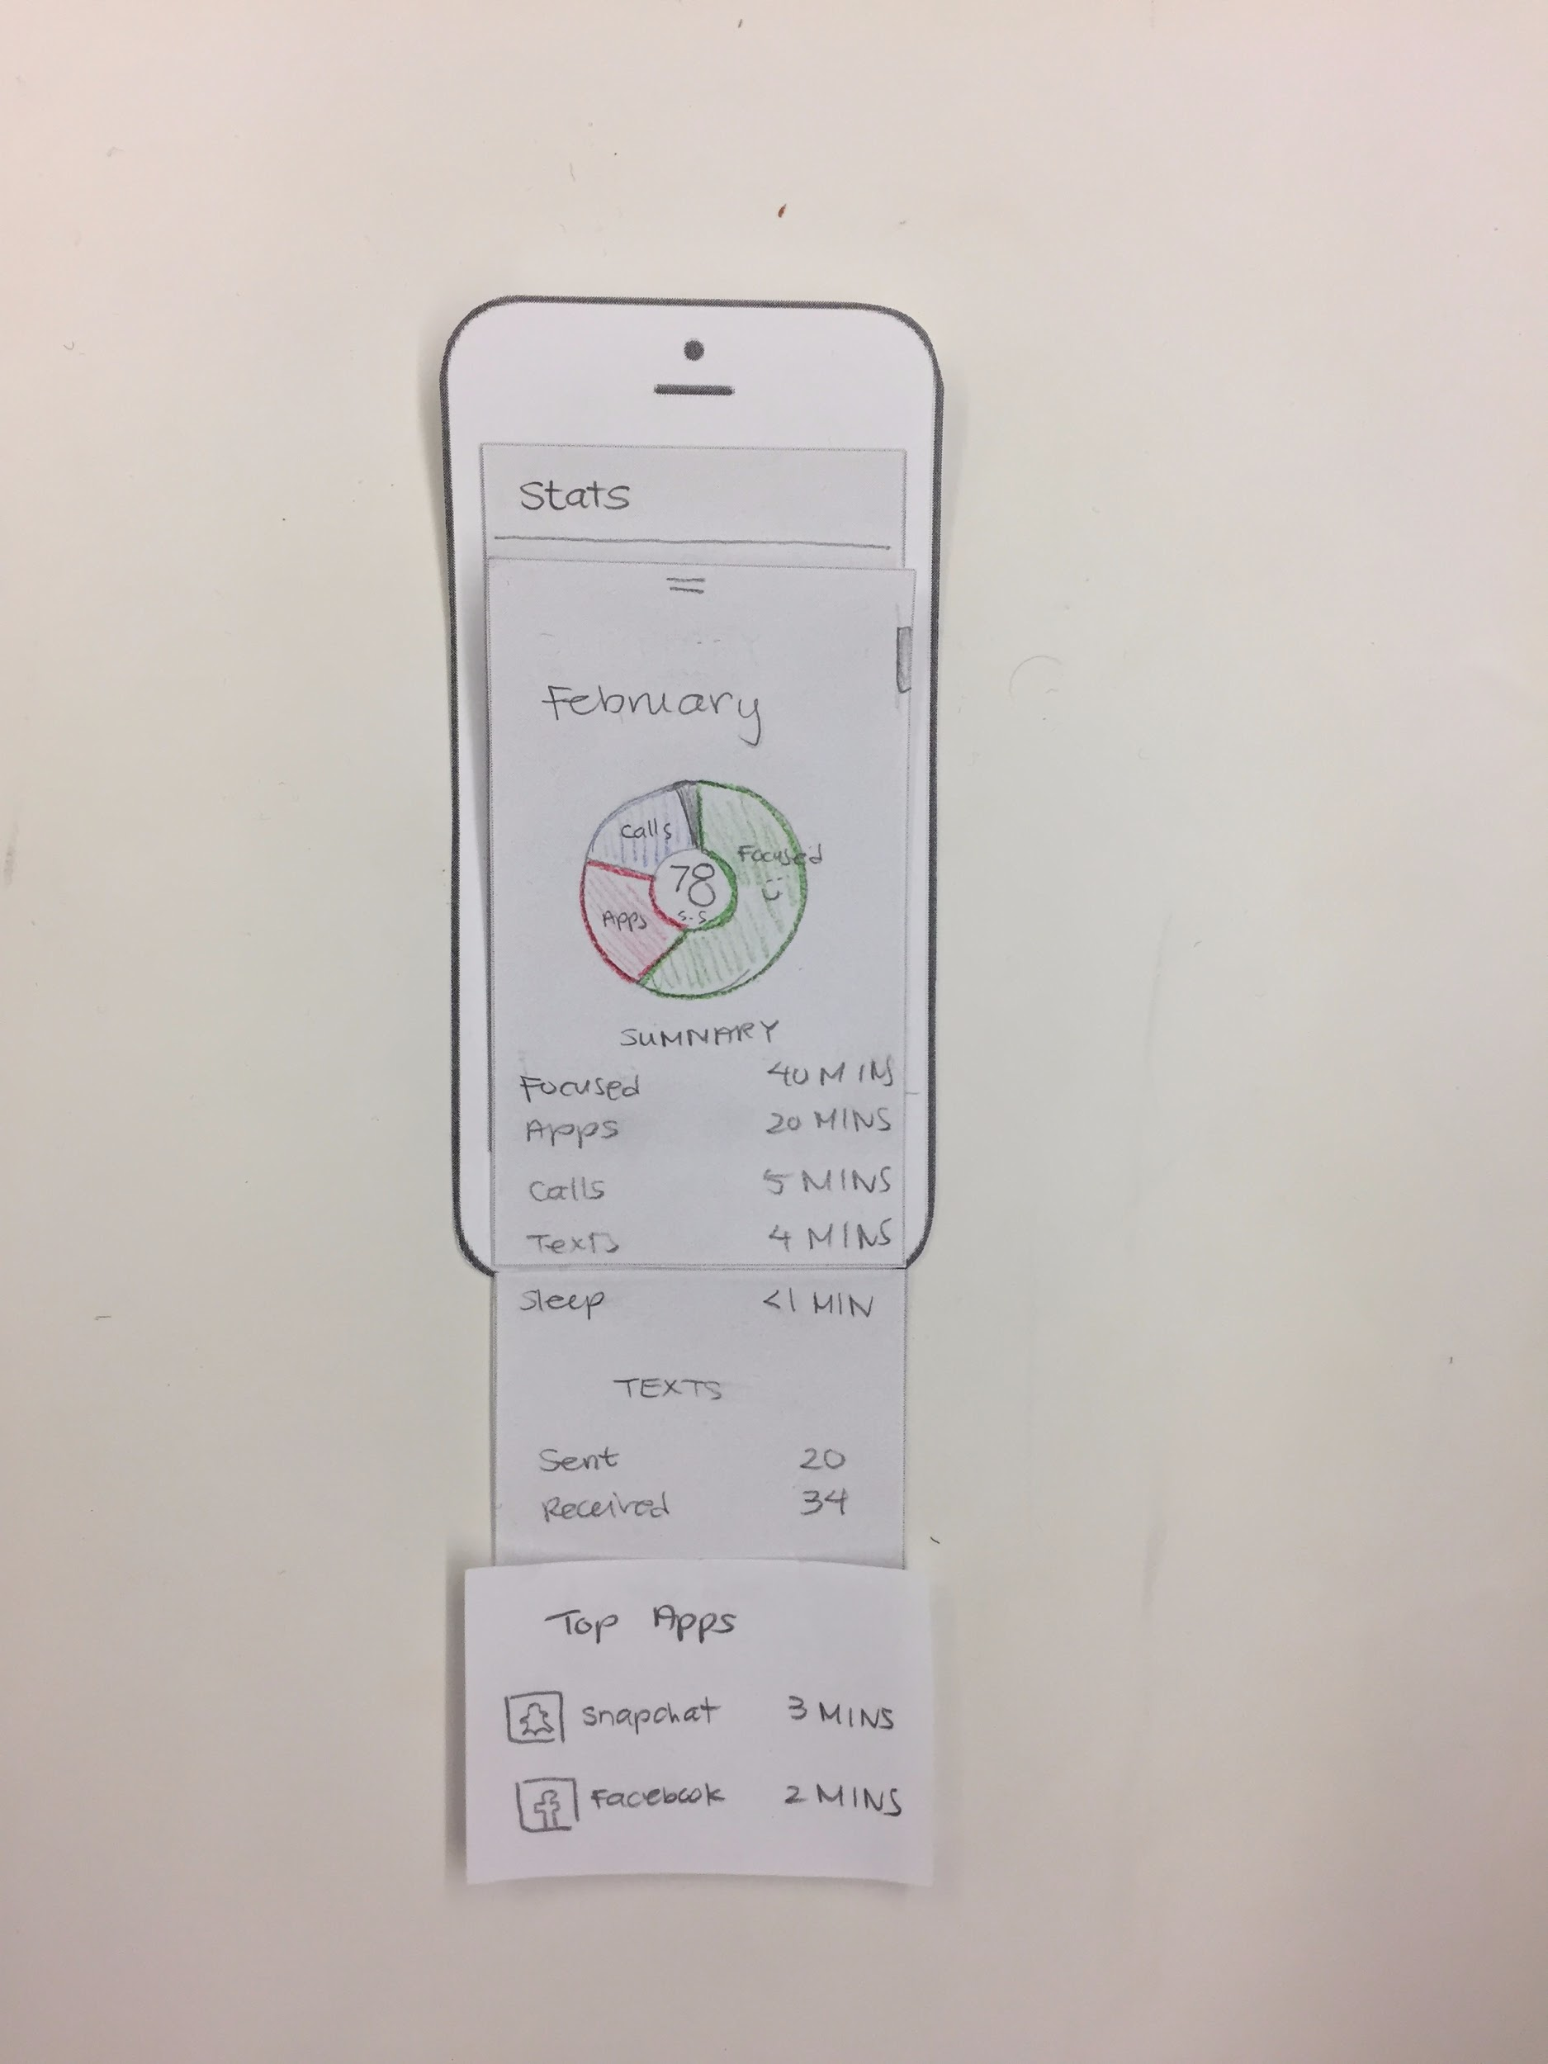
“Allowed activities” settings permitted illegal activities
So we added detailed stats “Top App”
about them instead

Slide 18
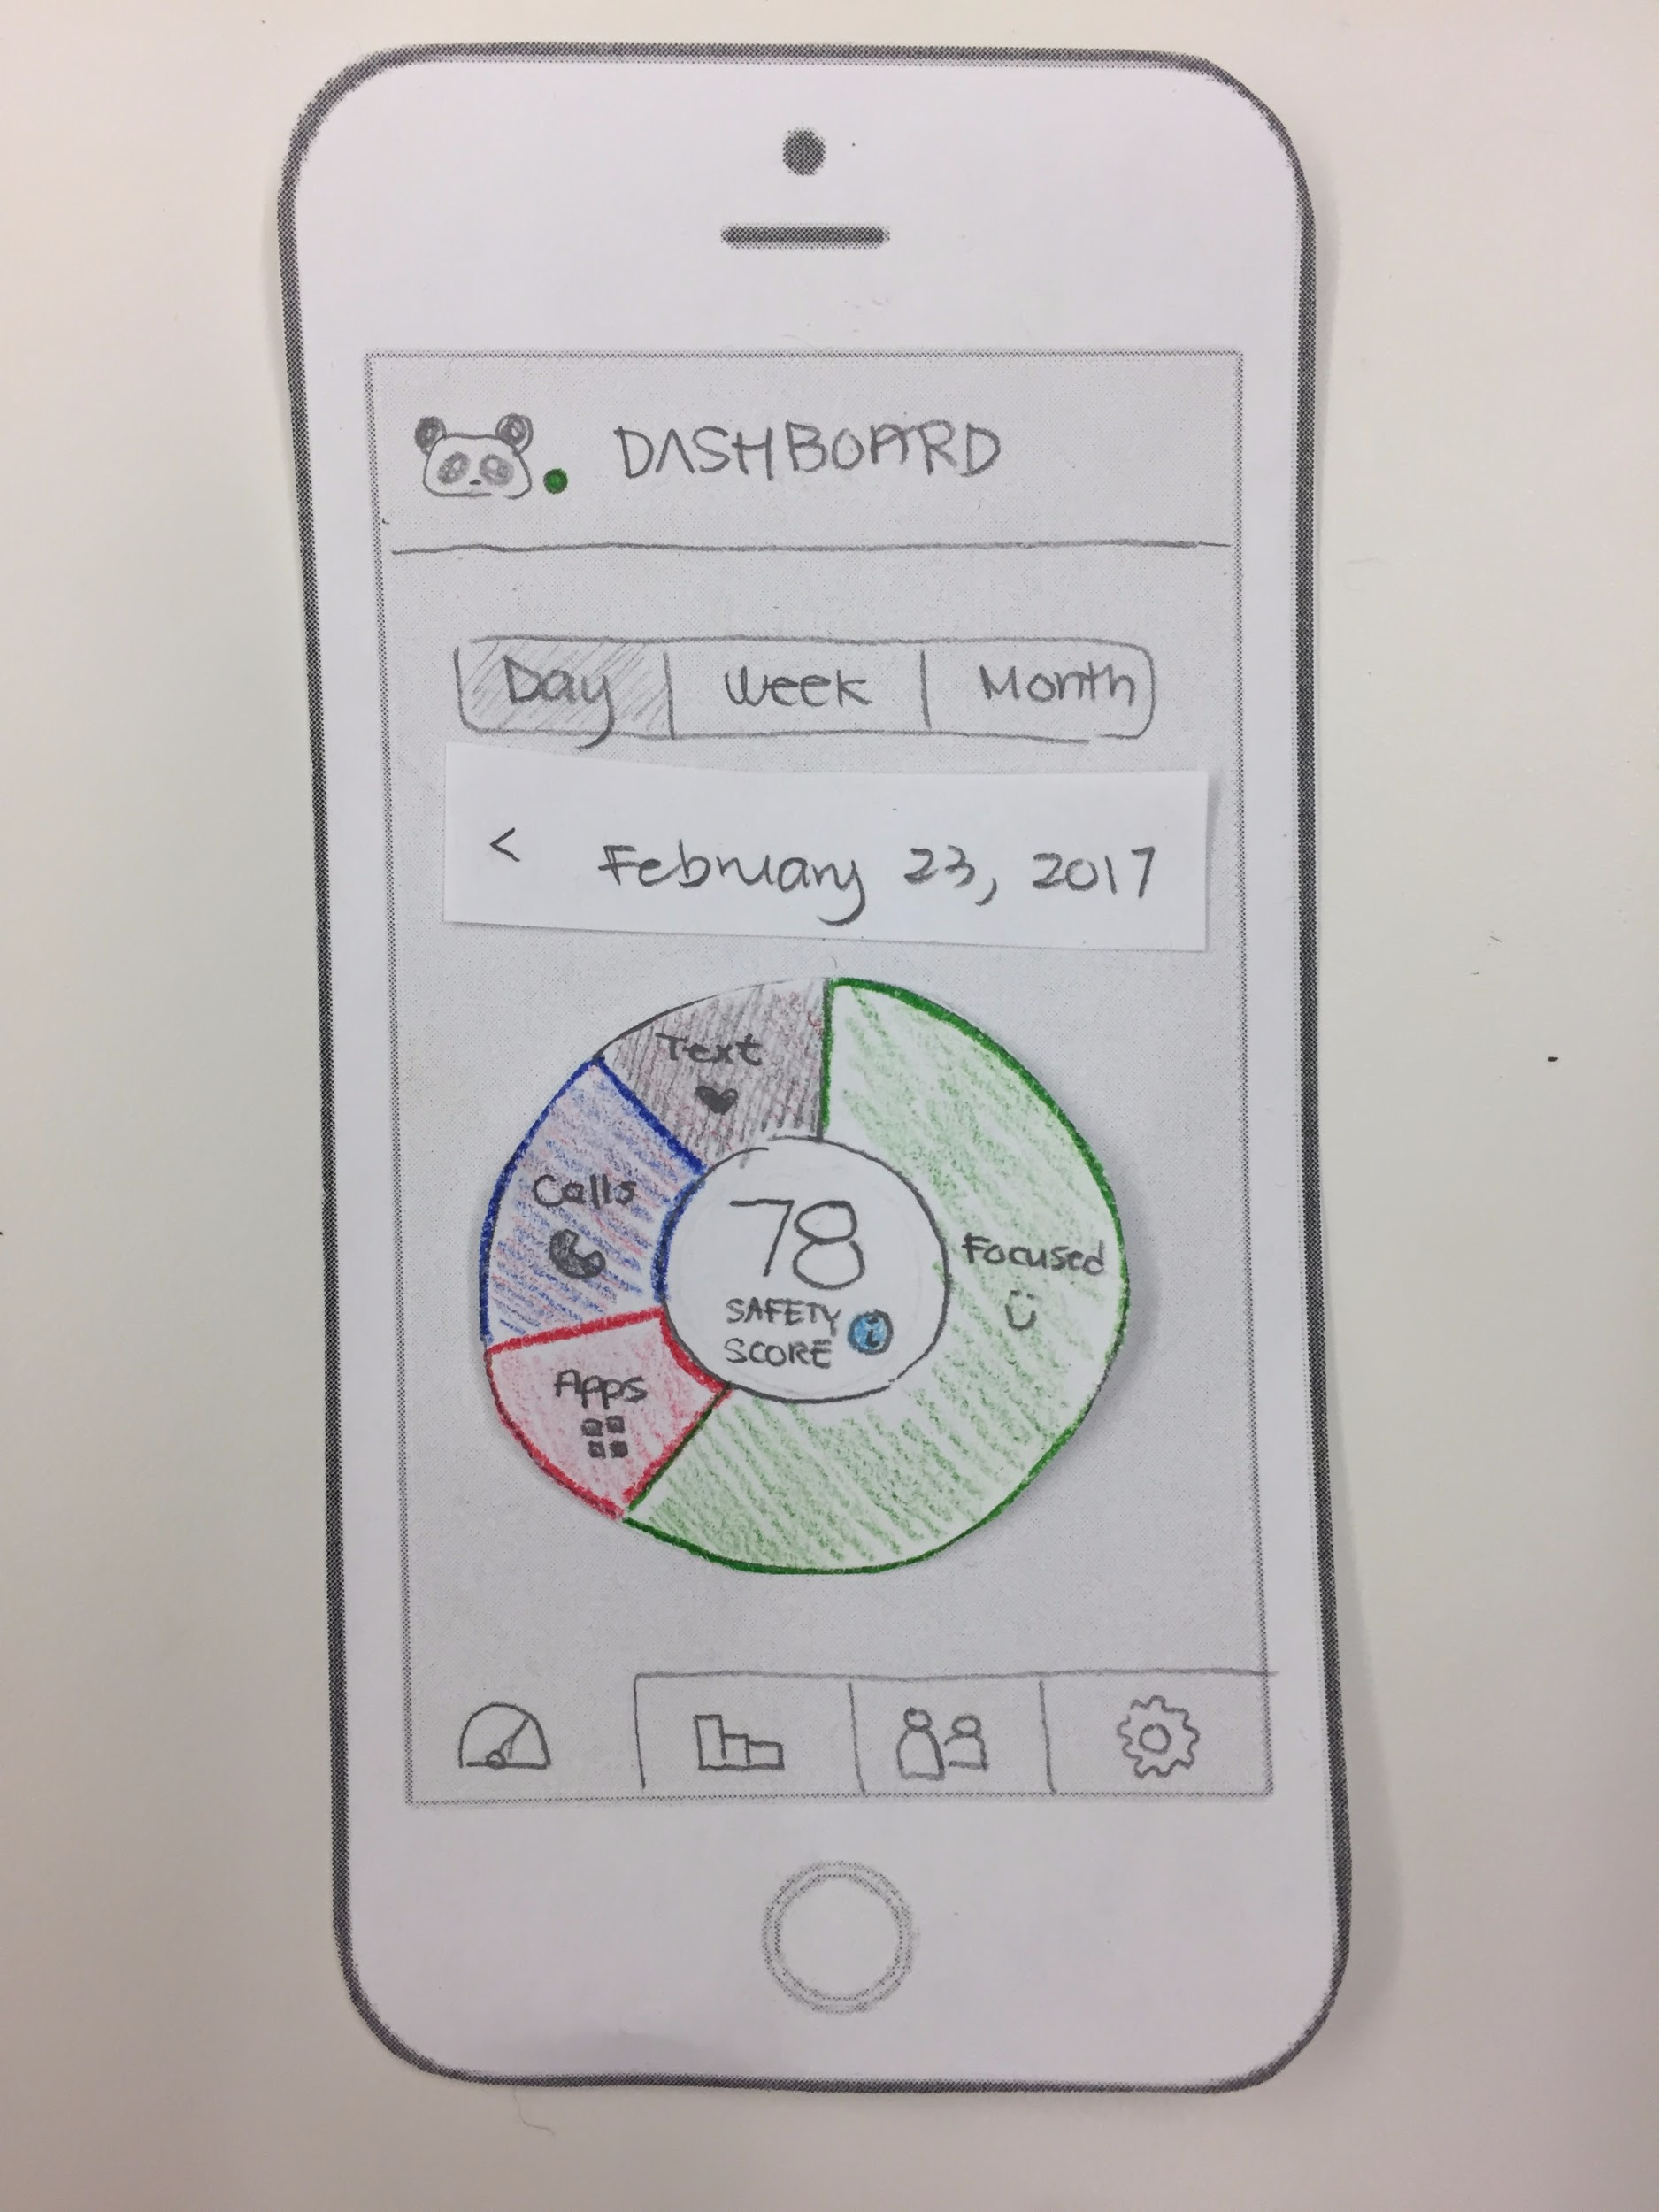
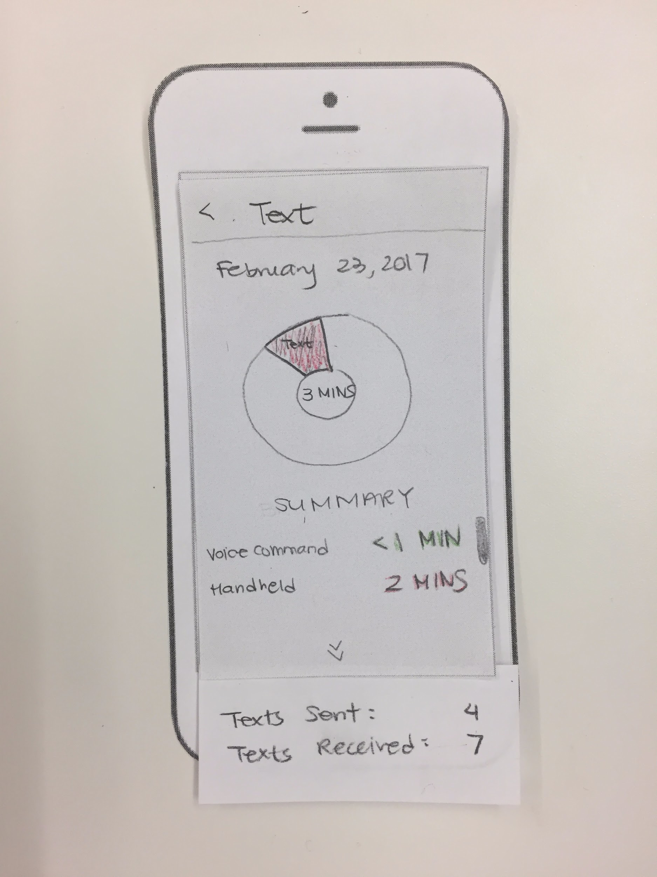
No detail view for data on stats or dashboard
So we added a detail view

Slide 19
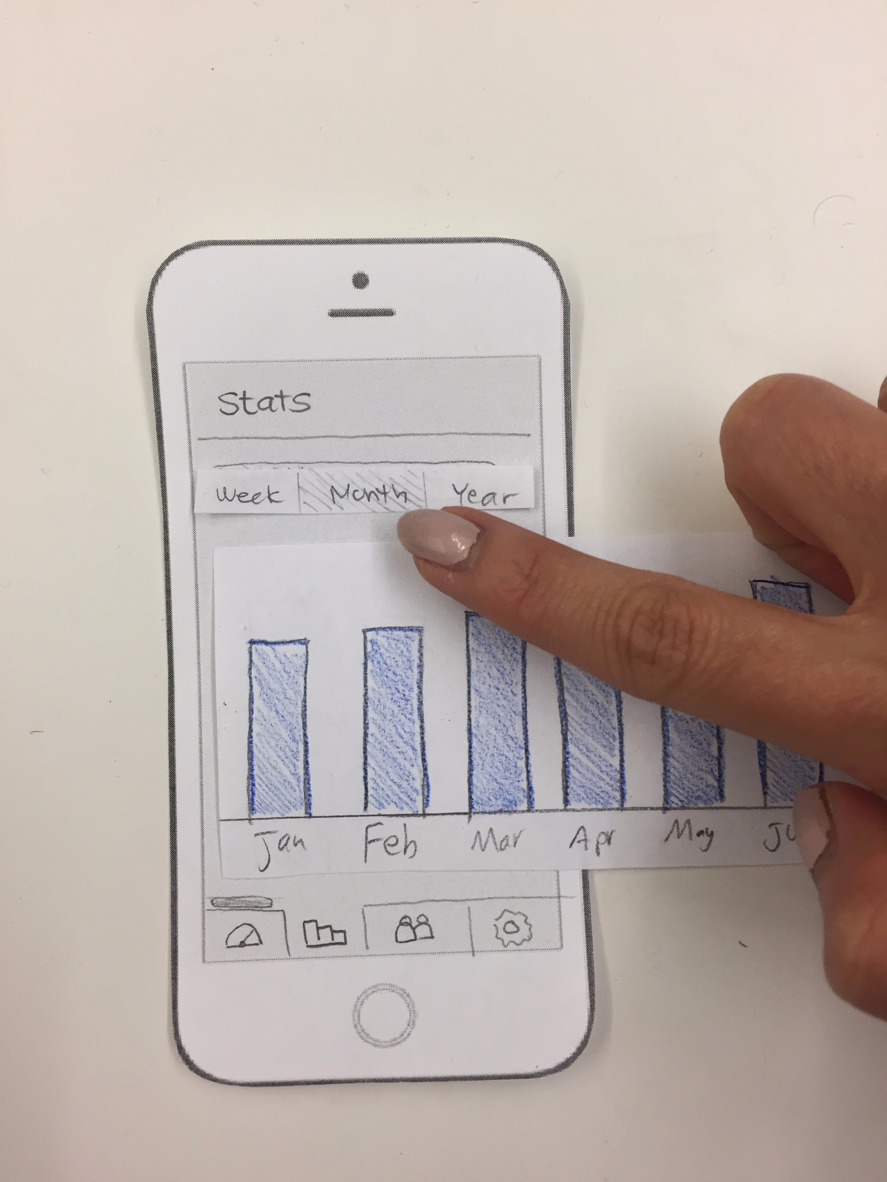
Stats graphs did not afford clicking or scrolling
So we made bars thicker and added a scrollbar

Slide 20
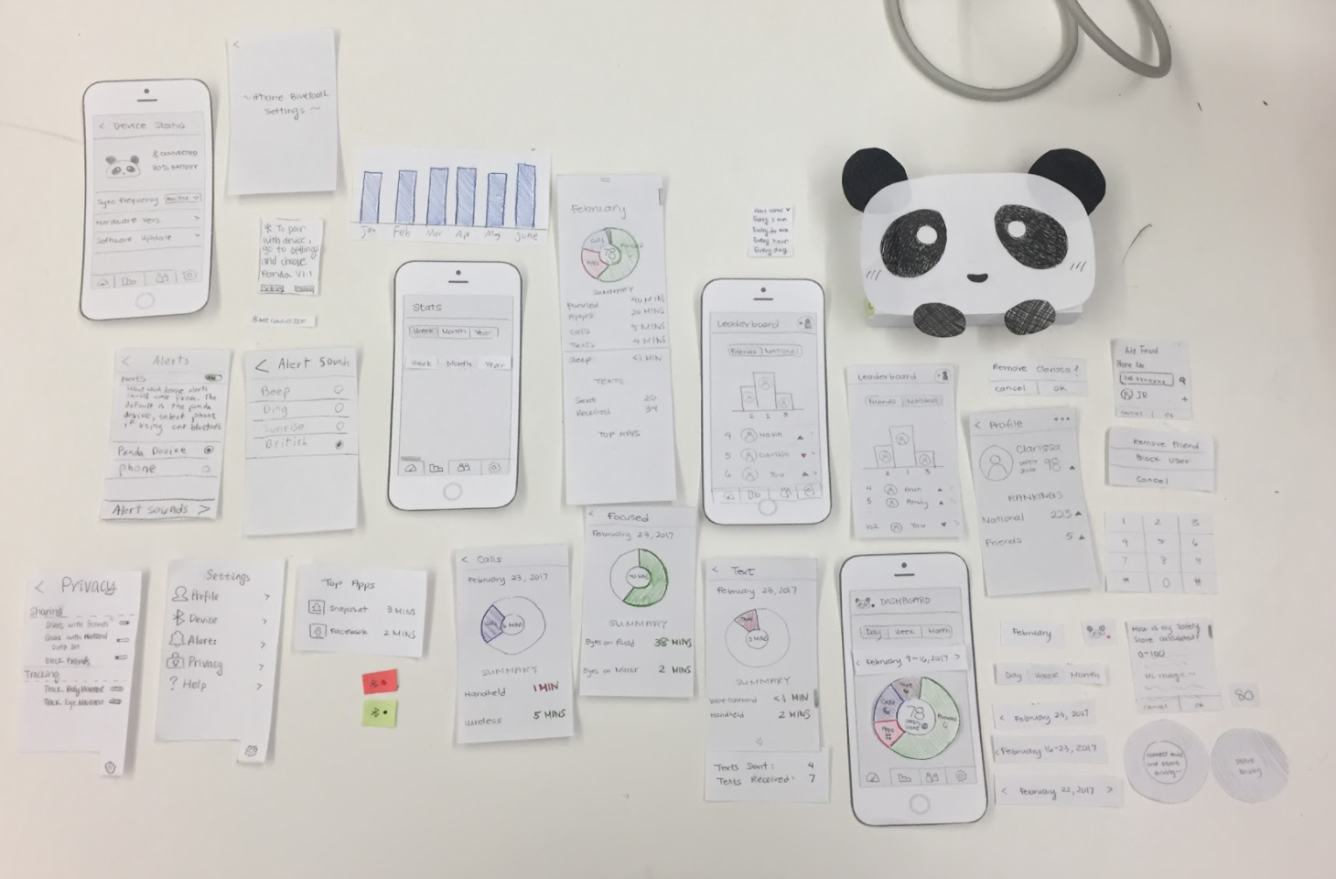
Final Paper Prototype | OVERVIEW

Slide 21
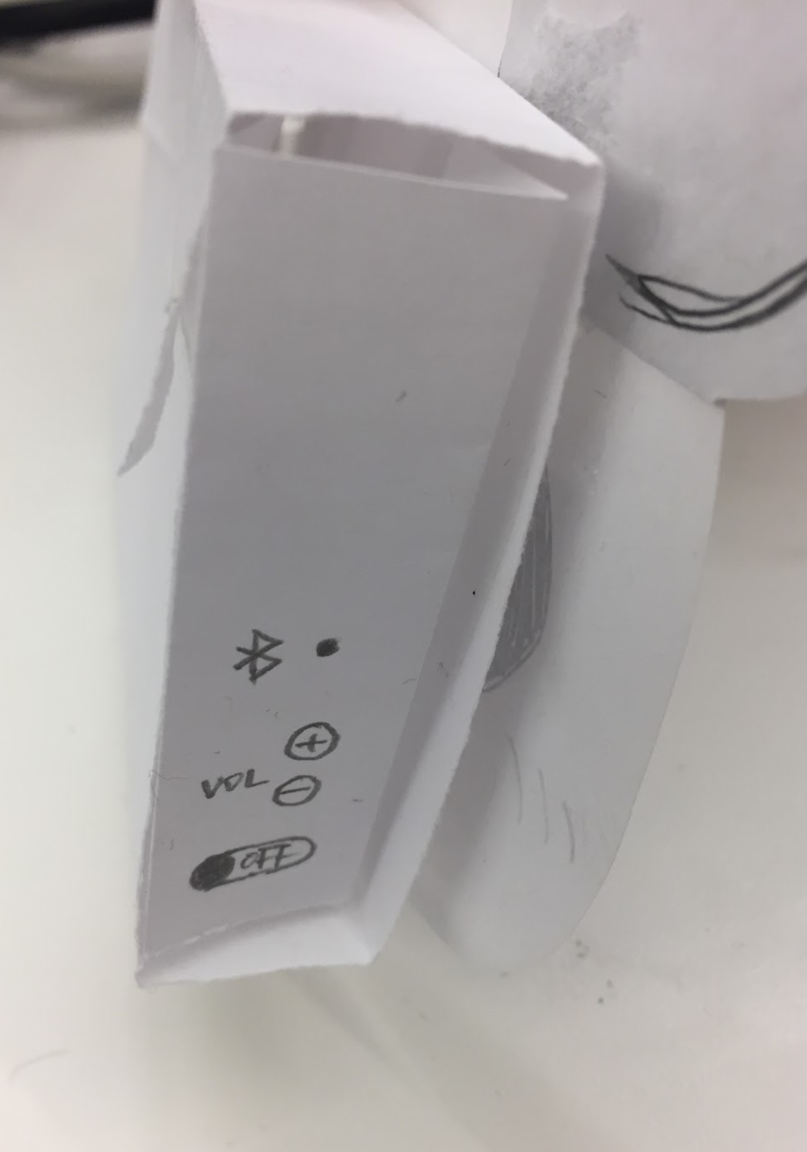
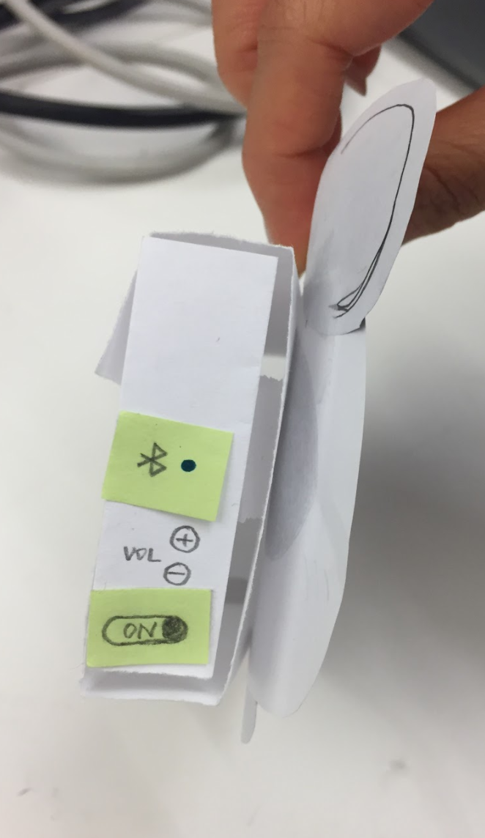
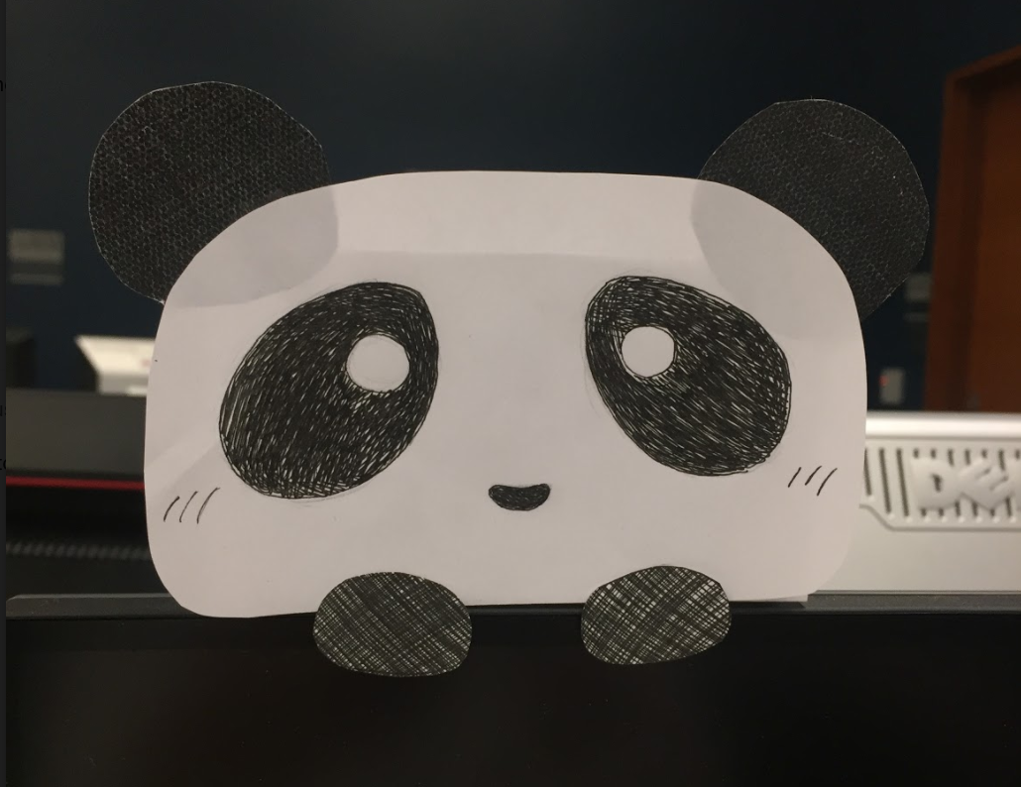
Final Paper Prototype
TASK 1: PROCESSING & VISUALIZING DATA
Clip on to Mirror → Buttons & Light on the left side

Slide 22
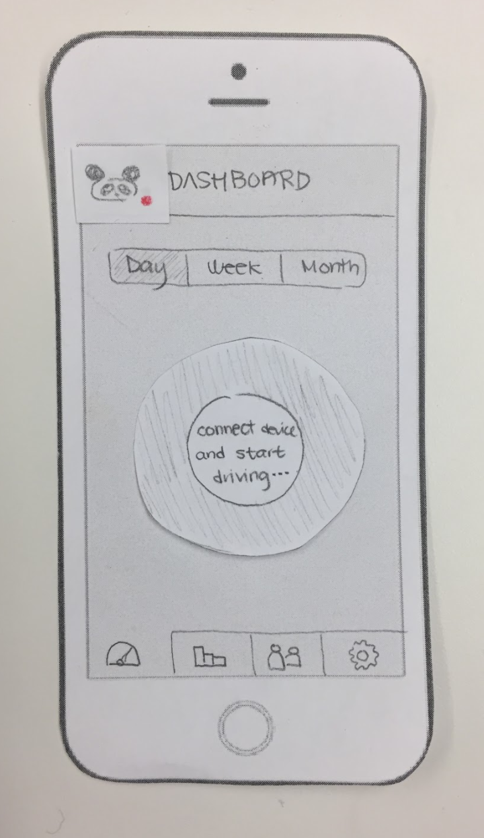
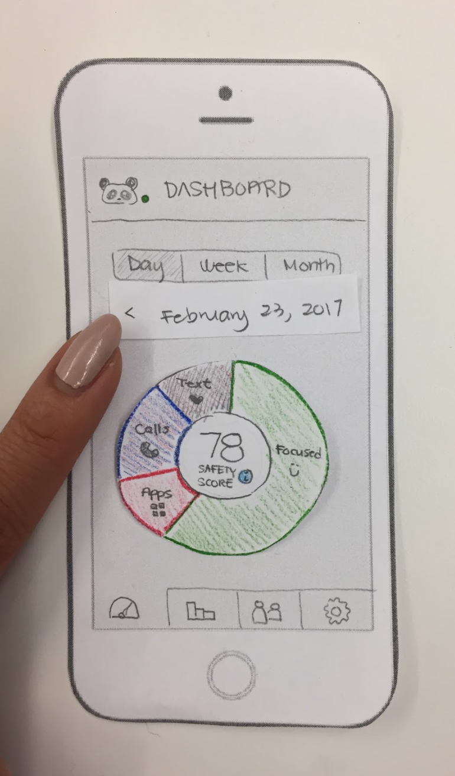
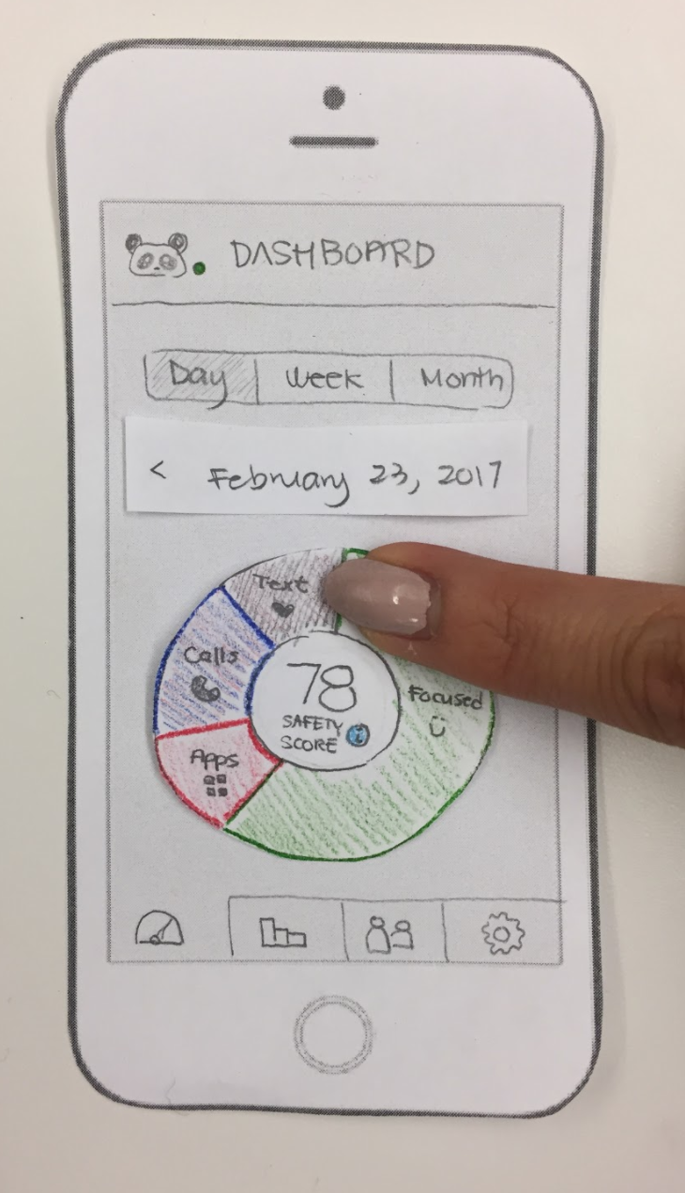
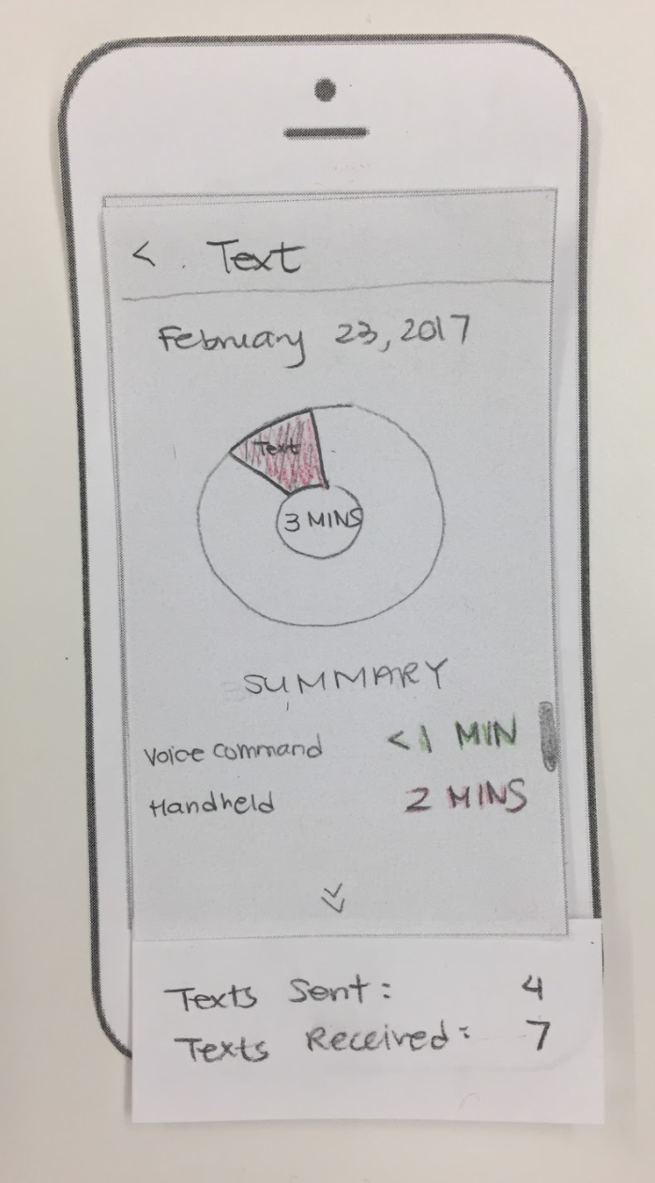
Final Paper Prototype
TASK 1: PROCESSING & VISUALIZING DATA
New User → Dashboard → Click on Pie Chart → Detailed View of Text

Slide 23
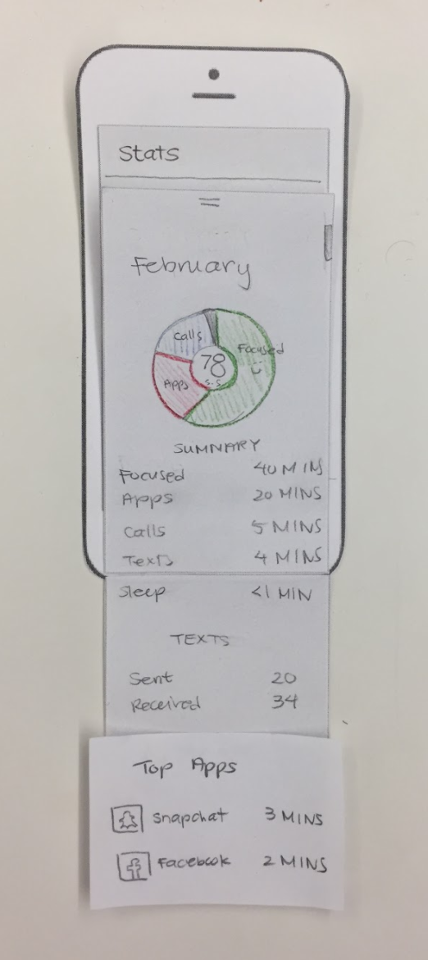
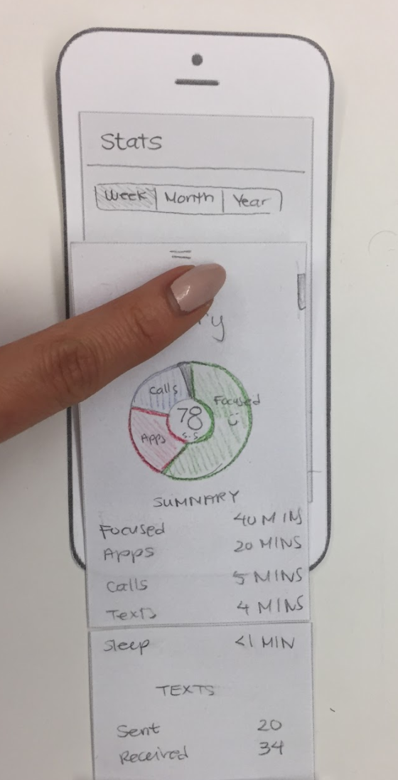
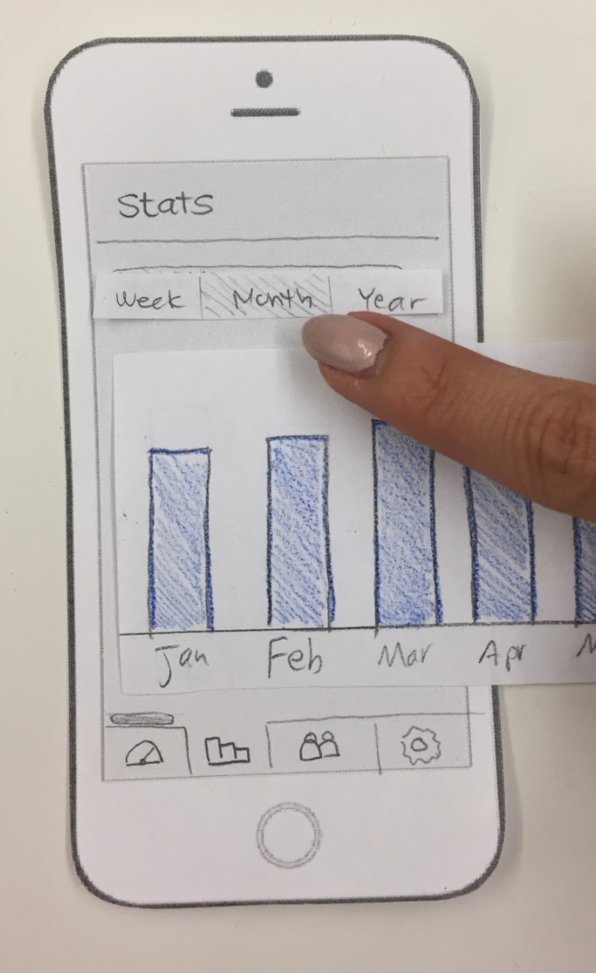
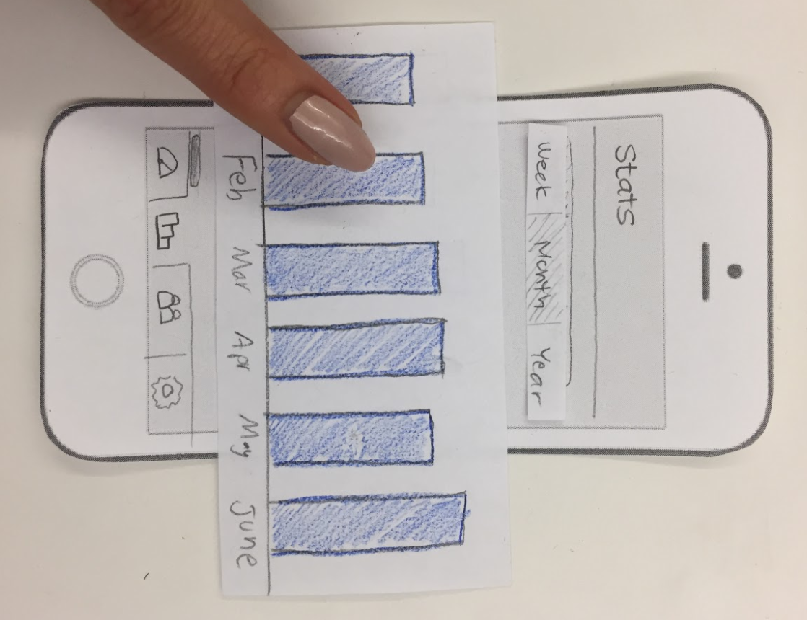
Final Paper Prototype
TASK 1: PROCESSING & VISUALIZING DATA
Monthly Stats → Click on Feb → Detailed View of Feb → Swipe Down

Slide 24
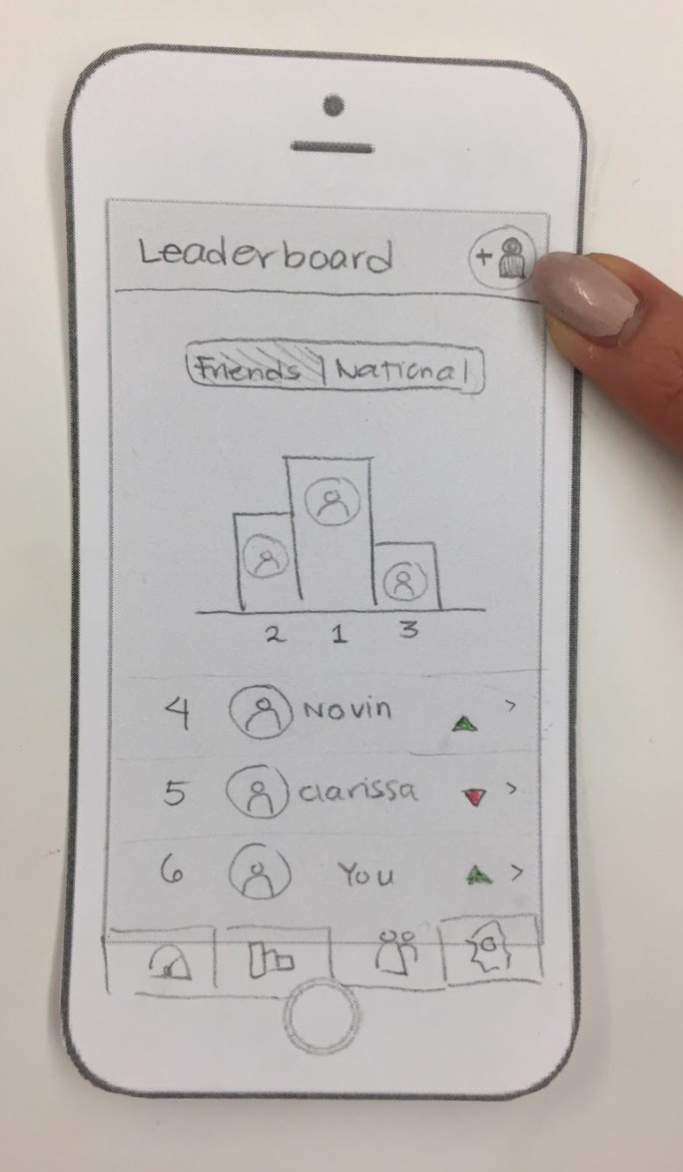
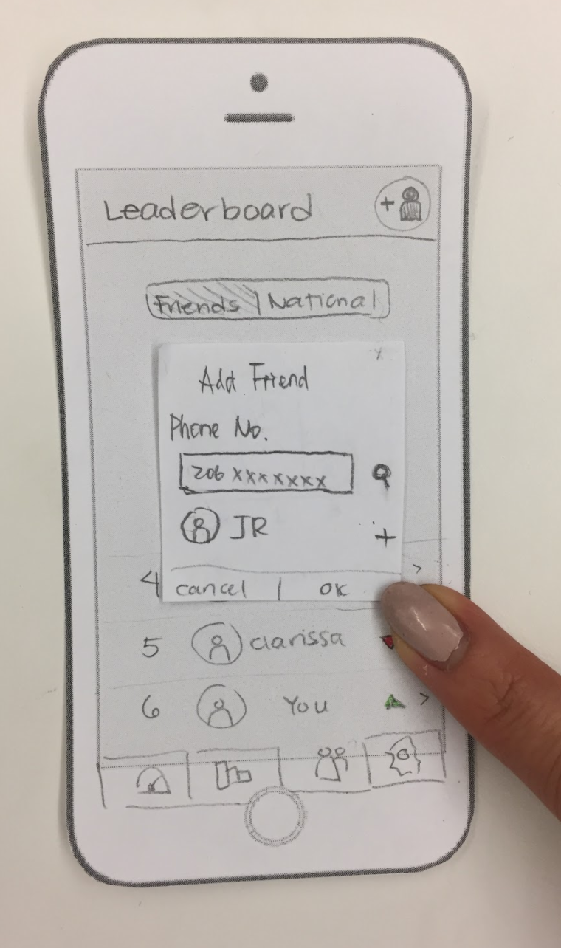
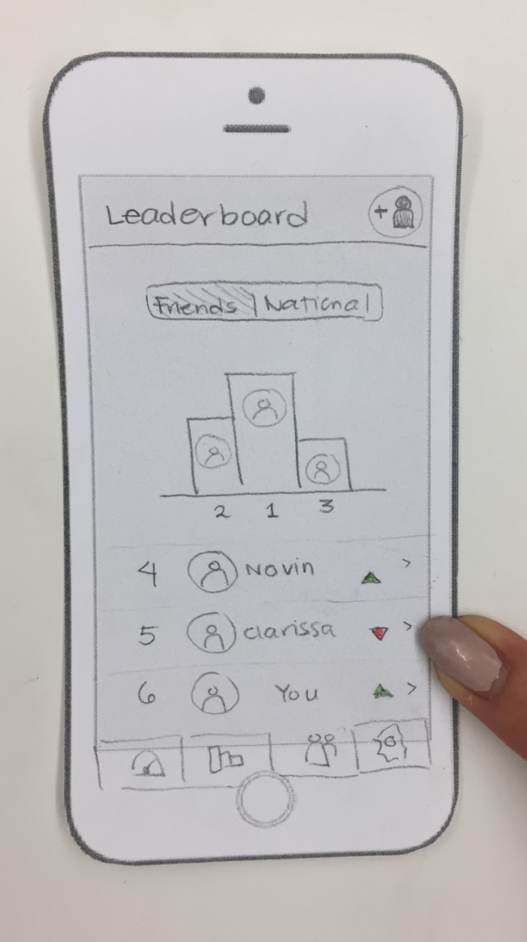
Final Paper Prototype
TASK 2: SHARING & COMPARING DRIVING HABITS
Add Friend → Find Friend → Checkout Friend

Slide 25
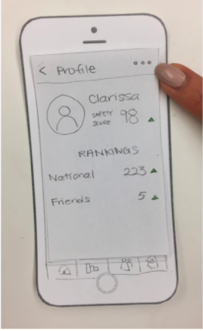
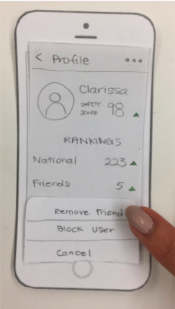
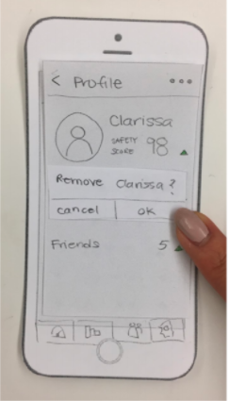
Final Paper Prototype
TASK 2: SHARING & COMPARING DRIVING HABITS
Option → Pick Action → Remove Friend

Slide 26
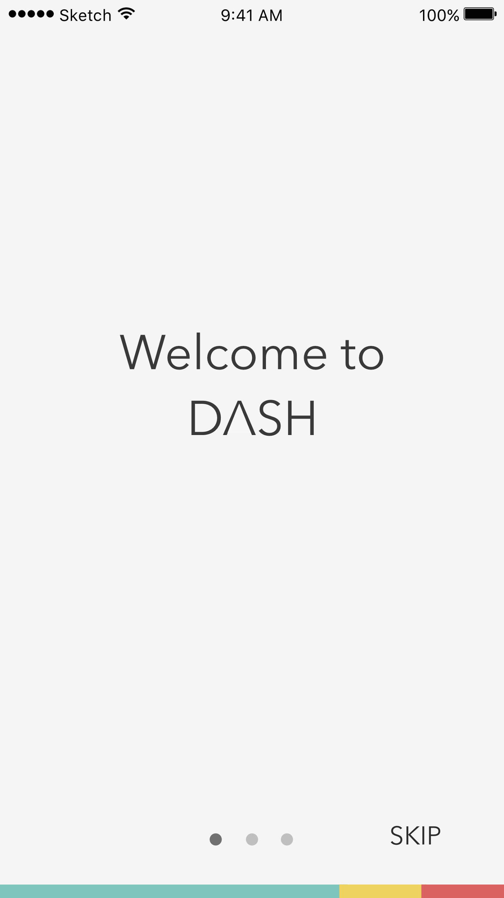
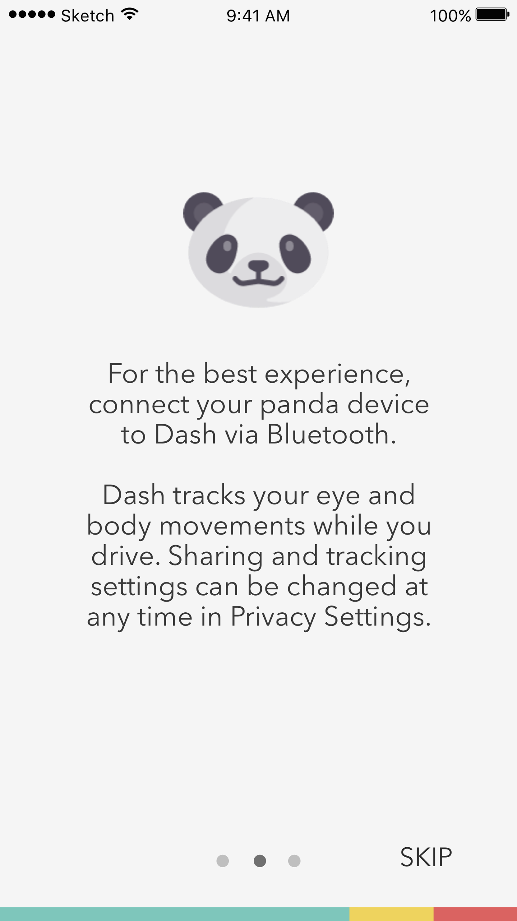
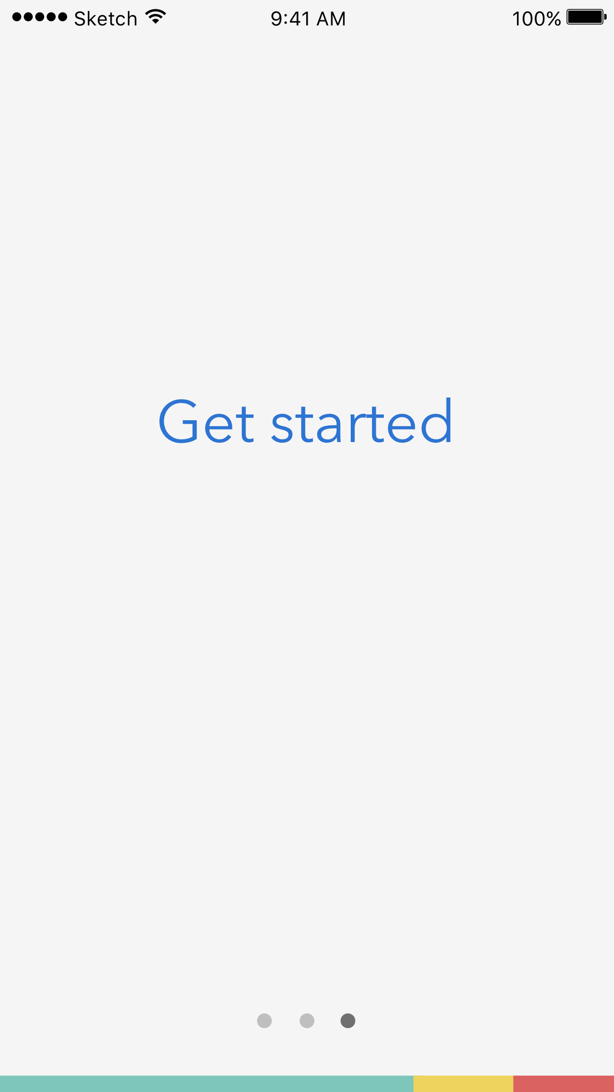
Digital Mockup
TUTORIAL
Notes:
TUTORIAL PAGES

Slide 27
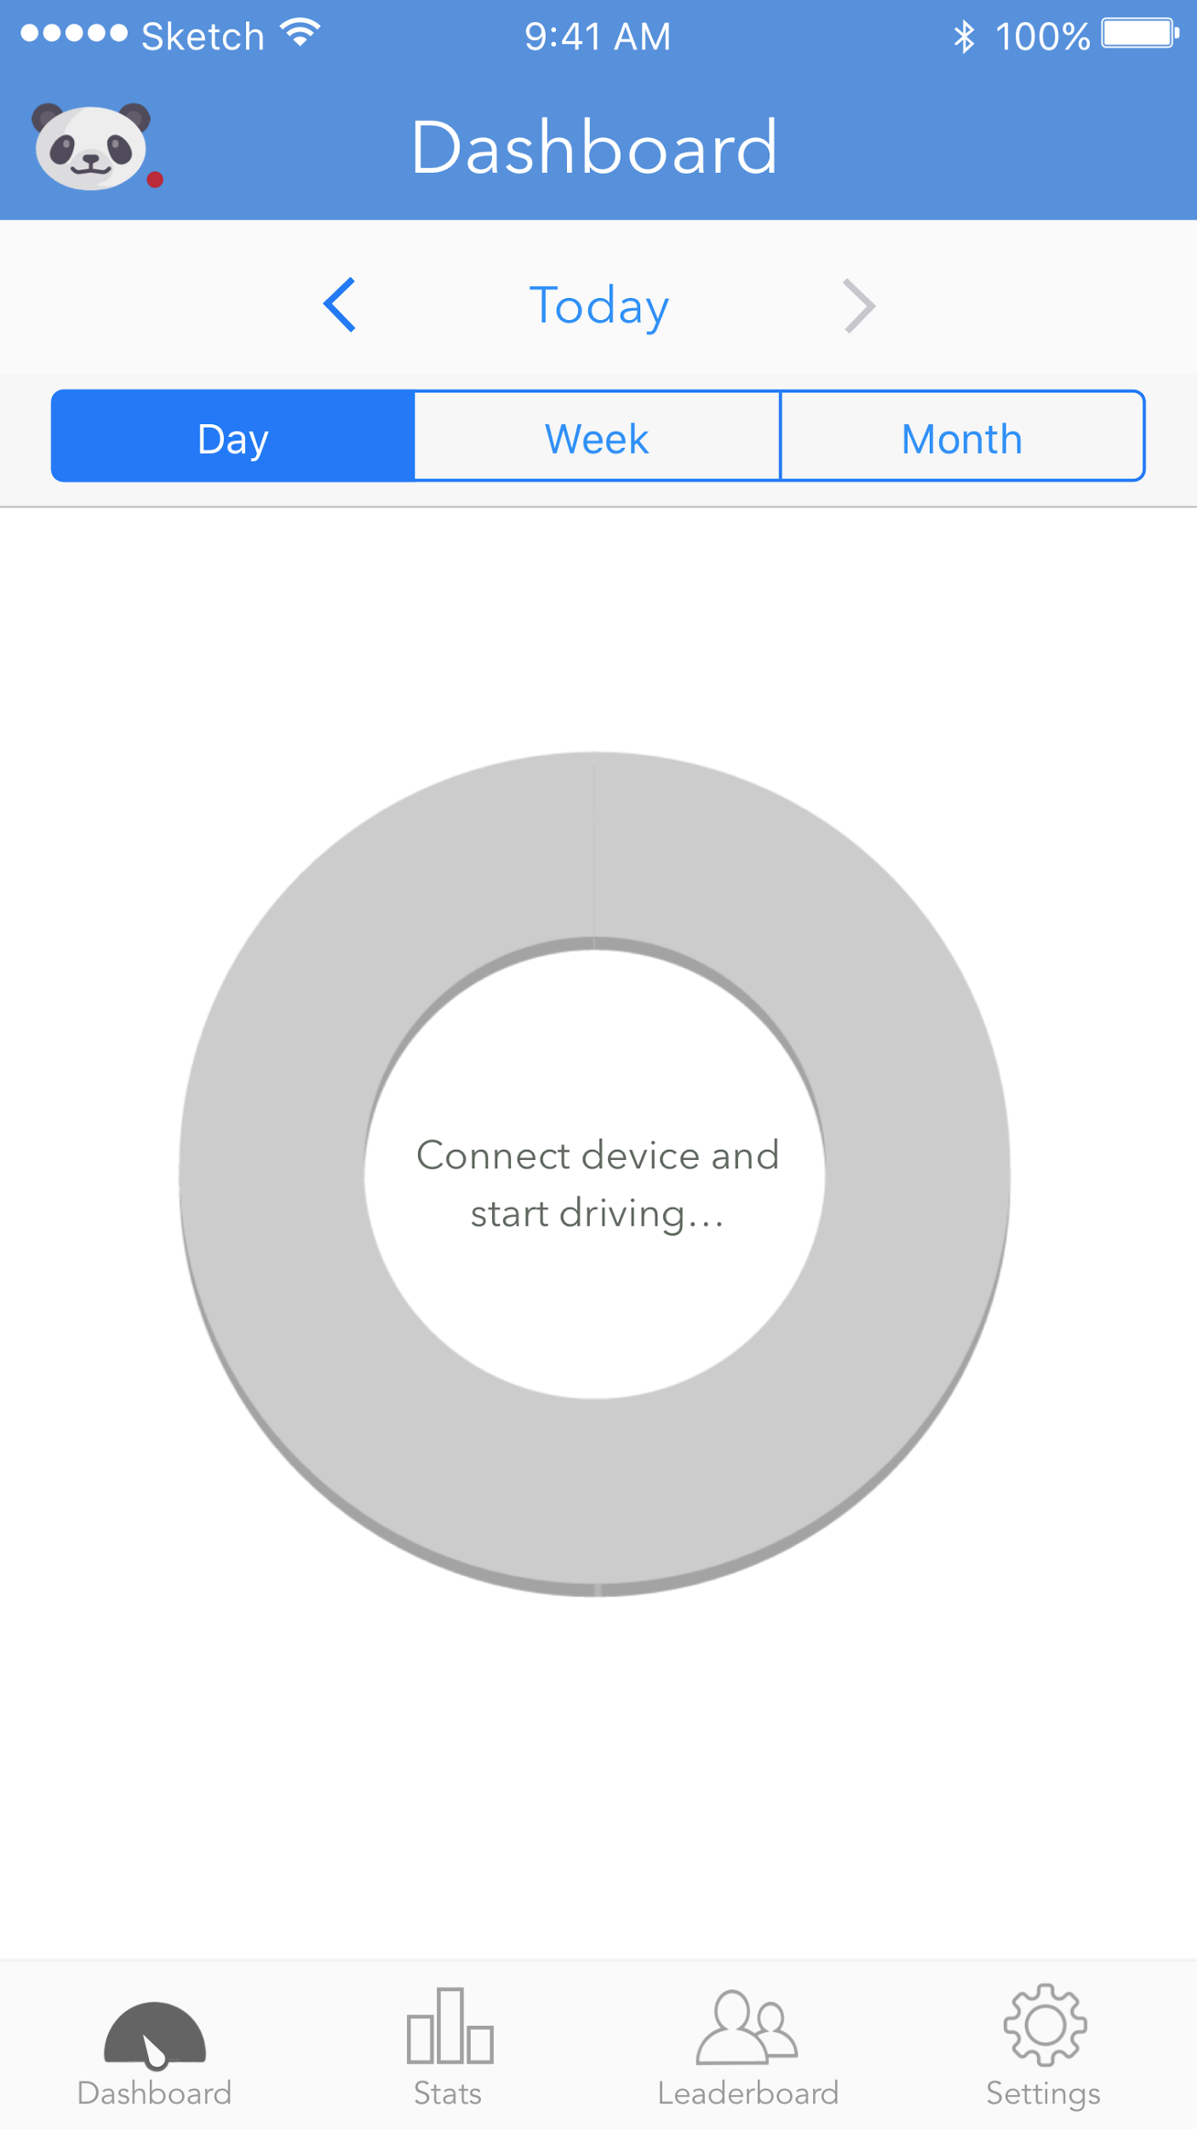

Digital Mockup
TASK 1: VISUALIZING & PROCESSING DRIVING DATA
Notes:
INITIAL VIEW WHEN DRIVER HASNT CONNECTED (SEE PANDA in upper right) OR HASNT DRIVEN YET
THEN…. DEFAULT VIEW

Slide 28


Digital Mockup
TASK 1: VISUALIZING & PROCESSING DRIVING DATA
Notes:
CHANGING DATE OF DASHBOARD
THE RESULT

Slide 29



Digital Mockup
TASK 1: VISUALIZING & PROCESSING DRIVING DATA
Notes:
CLICKING ON GRAPH SECTION
> FOCUSED
> APPS

Slide 30


Digital Mockup
TASK 1: VISUALIZING & PROCESSING DRIVING DATA
Notes:
DEMONSTRATES STATS SCROLL

Slide 31
Digital Mockup
TASK 1: VISUALIZING & PROCESSING DRIVING DATA
Notes:
CLICKING ON A BAR ON THE STATS PAGE…..

Slide 32


Digital Mockup
TASK 1: VISUALIZING & PROCESSING DRIVING DATA
Notes:
DETAIL VIEW OF STATS PAGE
DEMONSTRATES DETAIL SCROLL

Slide 33

Digital Mockup
TASK 2: SHARING & COMPARING DRIVING HABITS
Notes:
LEADERBOARD HOME

Slide 34
Digital Mockup
TASK 2: SHARING & COMPARING DRIVING HABITS
Notes:
CLICKING ON ADD FRIEND ICON

Slide 35



Digital Mockup
TASK 2: SHARING & COMPARING DRIVING HABITS
Notes:
ADD FRIEND:
CONNECTING APP TO FB
WHAT ADD FRIENDS LOOKS LIKE
SEARCHING FRIENDS BY NAME

Slide 36
Digital Mockup
TASK 2: SHARING & COMPARING DRIVING HABITS
Notes:
CLICKING ON A USER PROFILE

Slide 37


Digital Mockup
TASK 2: SHARING & COMPARING DRIVING HABITS
Notes:
USER PROFILE + CLICKING ON SETTINGS IN CORNER CAN LET YOU REMOVE THEM

Slide 38


Digital Mockup
SETTINGS
Notes:
SETTINGS AND PRIVACY SETTINGS

Slide 39



Digital Mockup
SETTINGS
Notes:
DEVICE SETTINGS + THE SYNC FREQUENCY
> BLUETOOTH PROMPT AUTOMATICALLY POPS UP IF NOT CONNECTED

Slide 40


Digital Mockup
SETTINGS
Notes:
MORE SETTINGS: ALERTS (CAN BE A NORMAL SOUND OR A VOICE REMINDER)

Slide 41
Summary
Initial design is never perfect
Prototyping and iterative testing are extremely effective in identifying areas of improvements
Stay low fidelity!

Slide 42
Questions?

